Slide 1
Practice Educators Course.
Physiotherapy BSc (Hons) and MSc (pre-reg)
BSc (Hons) and MSc (pre-reg) apprenticeship.
School of Sport and Health Sciences
University of Brighton
Physiotherapy placement team: Sarah-Jane Ryan, Tiffany Blackburn and Sara Hadland
EMAIL: physiotherapy-placements@brighton.ac.uk
TWITTER/X: @brightphysios
WEBSITE:Home | University of Brighton Supporting Health and Sport Students in Practice

Slide 2
Aims of the Session:
Review your learning from the SE AHP Practice educator training package.
What's happening nationally and locally to course provision/ ‘the Courses’
Guide you in the process of assessment, feedback and development with the CPAF form
To encourage your reflection on the kind of educator you are and want to be
What do you hope to get from the session? Any requests… Pop in the chat bar…

Slide 3
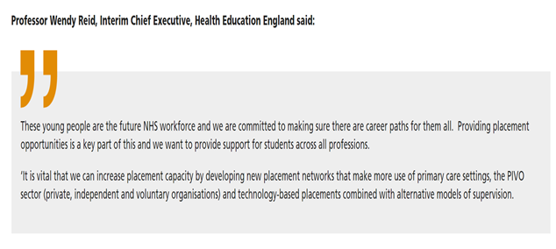
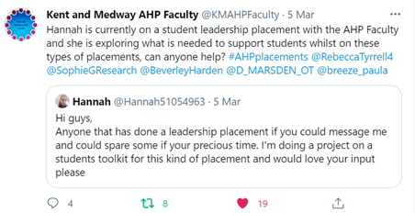
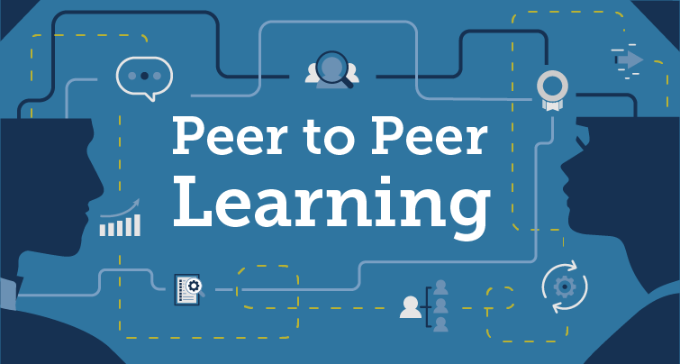
Notes:
Use this slide to contextualize practice learning at the moment:
Some of the pressures in terms of workforce and need for more graduates but needing more placements at a time when staff are stretched and retention is an issue
Change of HEE to NHSEI- placement traiffs, support fomr HEE with funding for AHP Faculties placement PEFS may change
Need to improve quality of practice leaning in response to NSS and NETS surveys
Placement tariff – not for international students or apprentices
Increasing use of alternative models such as peer to peer, CLIP, PAL, leadership, research etc.
Cost of living – impact on travel, accommodation, food, etc- students having to work more and this impacting on placement potentially
Needing to upskill students digitally for telehealth – using this with them on placement
Covid worries, risks and way services have changed
Students well-bing – increased anxiety (increase from Covid)

Slide 4
Developments in AHP Education
AHP Educator e-learning modules: Catalogue (learninghub.nhs.uk)
AHP Educator Workforce Strategy: Educator Workforce Strategy | Health Education England (hee.nhs.uk)
AHP Educator framework which is “an outcome based career framework that describes the knowledge, skills and behaviours required to be an effective teacher, learning facilitator, supervisor and role model in AHP education in practice and formal education settings. First and foremost, it promotes the education pillar of AHP professional practice, recognising that education is everyone’s responsibility”. Allied-Health-Professions-Educator-Framework.pdf (councilofdeans.org.uk)
‘Anti Racism in AHP education’ that provides 14 case studies to help address issues of racism and discrimination in Recruitment and retention l University-based learning l Practice-based learning l Transition to employment : Anti.racism.in_.ahp_.education.report.pdf (councilofdeans.org.uk)

Slide 5
Developments
CSP principles of practice-based learning Principles of Practice-based Learning CSP RCOT 2.pdf
School of Health and Sport Sciences, soon to be joined by School of Education.
Move to Falmer campus from Sept 2024 (all health programmes together)
Dr Angela Glynn (Physiotherapist) is the Dean of the School
Successful Revalidation for BSc and MSc courses, new programmes started Sept 2023 for next 5 years- thank you to all who supported us!
BSc and MSc Apprenticeship Course – Sept 2024/Sept 2025

Slide 6
Notes:
Add in here info about type of students, courses, structure, how you teach. How placements are structured. Types of experiences they need.

Slide 7
Key questions- what are you doing to prepare for your student?- induction, passports, creating a sense of belonging? Expectations- how do your expectations for your placement change between levels of the students? First placement etc. expectations of an apprentice, an MSc, a BSc? Where is this information, how do you share it with your students? To consider- What is the most challenging thing about your environment…think of previous students, band 5 you work with, your own experiences starting in your role? How could you plan to mitigate the above?
Module 1: Getting started

Slide 8
Our Edublog with resources to help you prepare: Home | University of Brighton Supporting Health and Sport Students in Practice https://blogs.brighton.ac.uk/uobsupportinghealthandsportstudentsinpractice/physiotherapy/ on the edublog site Placement dates: Placement dates | University of Brighton Supporting Health and Sport Students in Practice Student passport and Educator passport: Educator passport | University of Brighton Supporting Health and Sport Students in Practice Supporting Black, Asian and Mixed Heritage Students: Resources for educators | University of Brighton Supporting Health and Sport Students in Practice
Getting started- useful UoB links

Slide 9
Activity- breakout groups to discuss our 3 cases. Groups 1-3 please look at case 1 Groups 4-6 please look at case 2 Groups 7-9 please look at case 3 Questions to ask: What are your assumptions/biases? How confident are you supporting students with protected characteristics? What are the key things that you need to consider? How can you educate yourselves further to help learners feel supported?

Slide 10
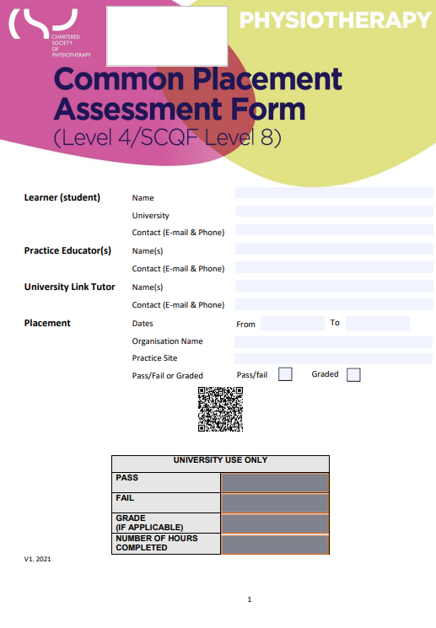
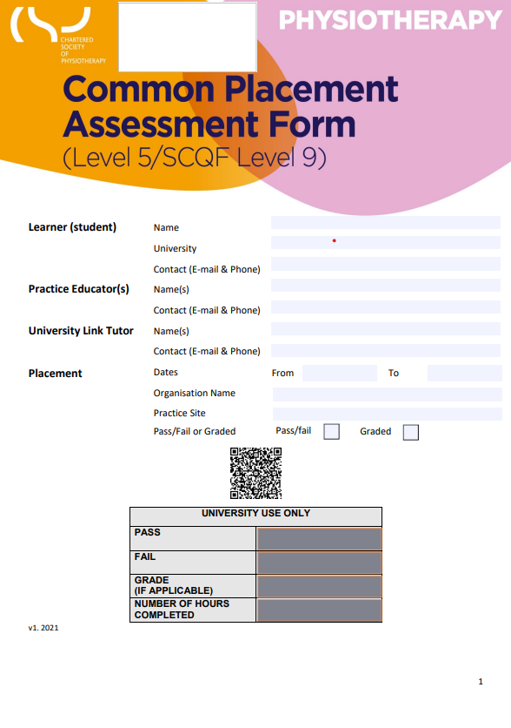
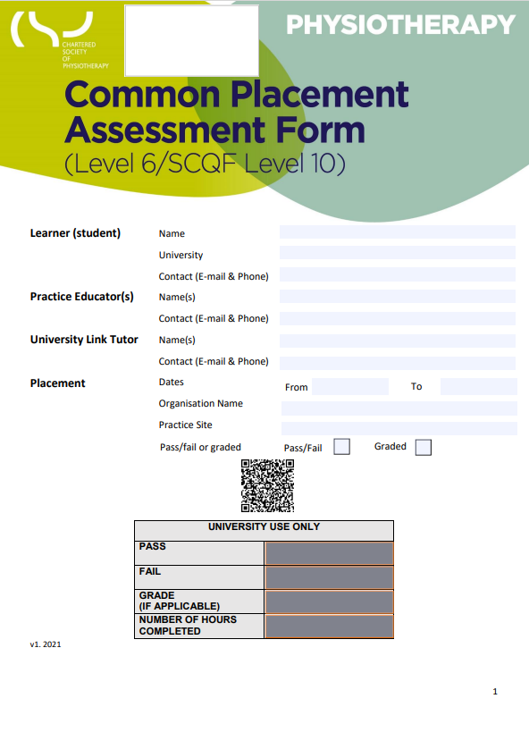
You might find it useful to revisit the teaching strategies and models introduced in module 2, GROW model, PLUS etc. Consider how it will apply to your style of education, different students and your environment? This can help you to prepare for the assessment as part of a successful placement. School policies and Guidance: School of Sport and Health Sciences Guidance documents for Practice Learning | University of Brighton Supporting Health and Sport Students in Practice Common placement assessment form (CPAF) https://www.csp.org.uk/professional-clinical/practice-based-learning/cpaf
Module 2: Hosting a successful placement

Slide 11
Raising concerns – reflective questions What experiences do you have of students raising / not raising concerns? Why might students not report concerns to you or your team? How do you help to make your students feel safe? How confident do you feel supporting students who raise concerns? What discussions can you have at induction stage and how will you regularly check in with students and give them safe space to raise concerns? Do you need extra support to raise concerns about learners? What support do you need / can we provide for you?

Slide 12
Some Ideas
Create an open culture where students feel safe to talk though concerns- remember that a sense of belonging and the trust they have in you as an educator is important
Include discussions in induction – don’t just ask them to look at a policy, show them how this is enacted in practice
Arrange time for them to meet with safeguarding lead or Speak up Guardian or other networks in your organisation
Make sure they know who can they can go to if they have concerns that they are worried about raising with you as their assessor
Make sure that concerns raised by students or concerns you have about a student are not discussed widely in the team- ensure their confidentiality
Gain consent from student to share their concerns with others (aware that if someone is at harm then this overrides this)
Contact the placement lead at the HEI for advice

Slide 13
Activity- breakout groups to discuss our 2 cases. Questions to ask: How confident are you supporting multiple students? What are the benefits of supporting the multiple model How can you educate yourselves further to help learners feel supported? https://www.csp.org.uk/professional-clinical/practice-based-learning/supervision-models https://www.hee.nhs.uk/about/how-we-work/your-area/midlands/midlands-news/guide-practice-based-learning-neurodivergent-students

Slide 14
What placements should a student do? What do you think the benefits of leadership, hybrid, diverse, research placements are for our future graduates? Resources, guidance documents and examples: Models of Placements Delivery | University of Brighton Supporting Health and Sport Students in Practice So what about you……. - How will you use being an educator to link to your own CPD? - Consider linking your development as an educator to the 4 pillars - - -- HCPC audit evidence - good placements link to recruitment and retention. Post Grad PG cert / HE714 module : Leading Practice Education PGCert (brighton.ac.uk)
Module 3: The future

Slide 15
Support for you?
Contacts: Sarah-Jane Ryan, Tiffany Blackburn & Sara Hadland Physiotherapy-placements@brighton.ac.uk
Supporting Health and Sport Students in Practice Edublog: About Us | University of Brighton Supporting Health and Sport Students in Practice
Half-way calls from academic staff.
Newsletters: Newsletter | University of Brighton Supporting Health and Sport Students in Practice
ICS Placement team (AHP educator network meetings) and Practice Facilitators (PEF) in your organisations
https://www.csp.org.uk/professional-clinical/cpd-education/csp-eportfolio-learning-hub
Remember that feeling when you had a good placement, and equally when you were made to feel like 'The student’.
It is the student's responsibility to learn, but it is your responsibility to create an environment to support them achieving their best…..you got this!

Slide 16
Thank you for your time and engagement today, looking forward to working with you in the future.

