Slide 1
Practice Learning Awards 2022
School of Sport and Health Sciences

Slide 2
Welcome
Dr Channine Clarke, Head of Practice Learning and Development
With special thanks to Mia Sirota-Gott, Jaymee Rubin, Joseph Barsoum and Eufrazia Da Costa Moniz (Nursing students), for helping to coordinate today’s awards.

Slide 3
Thank you
From
Juliet Borwell
Practice Learning Programme Lead
South East Region
Health Education England

Slide 4
The Extra Mile Award
Shortlist are……

Slide 5
Extra Mile shortlist
MARIA GRIFFIN
COURTNEY VINT
KIRSTY FLETCHER
GILL TANNER
And the winner is…….

Slide 6
WINNER- EXTRA MILE AWARD
COURTNEY VINT
Occupational Therapist, Sussex Partnership NHS Foundation Trust

Slide 7
The Most Inclusive Person
Shortlist are……

Slide 8
The Most Inclusive Person
JO SOUTHALL
PAIGE BARR
ELLE SOUDEN
ELISA CAMPONESCHI
AMOR FORDE
And the winner is….

Slide 9
WINNER- MOST INCLUSIVE PERSON
JO SOUTHALL
Occupational Therapy and Physiotherapy Educator

Slide 10
Canva link

Slide 11
Fabulous, thank you
I am so delighted to announce this wonderful news to the entire team
well that's super nice!
Aw thanks so much that’s lovely to read
Thank you! that's great to hear
Well that is very exciting! Thanks so much 😊
Ah what great news🙂 Thank you very much.
Oh my goodness thanks so much!
Wow! I feel very humbled by this.
Thank you very much for this
I really appreciate it
I was very pleasantly surprised to receive two emails from you with nominations for both myself and for the team from my student
Thank you so much, It is great to be nominated
Thank you this is really lovely to hear!!
What a lovely email to receive thank you, I will pass onto the team!

Slide 12
TEAM OF THE YEAR Award
Shortlist are……

Slide 13
Team of the year shortlist
STEVE NICHOLLS AND SECAMB
STANBOROUGH PE DEPARTMENT
ICU AT THE ROYAL SUSSEX COUNTY HOSPITAL
PHYSIOTHERAPY FRAILTY TEAM
THE RYE REHABILITATION TEAM
LIVE IT AND LOVE IT TEAM
OXSTED SCHOOL PE DEPARTMENT
And the winner is…….

Slide 14
WINNER- TEAM OF THE YEAR
RYE REHABILITATION TEAM
East Sussex Hospitals NHS Trust

Slide 15
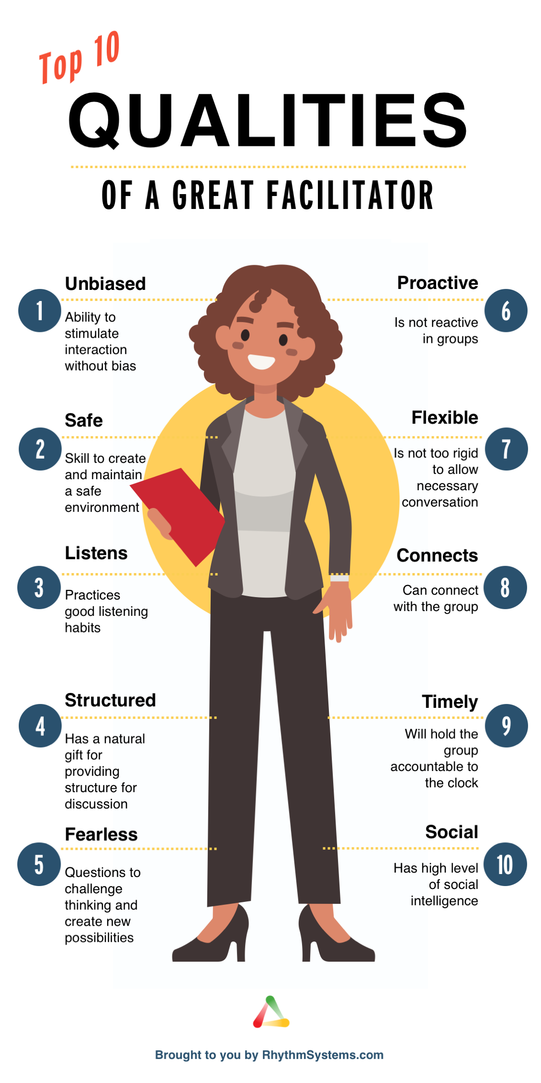
Practice facilitator of the year Award
Shortlist are……

Slide 16
Facilitator of the year shortlist
OLIVER EWING
SARAH ELLIOTT
BEN COFFEY
ERNA BENVENUTI
COURTNEY VINT
DANIELLE VERALL
RYAN CAMP
And the winner is…….

Slide 17
WINNER- FACILITATOR OF THE YEAR
BEN COFFEY
Clinical Director
Specialist Soft Tissue & Joint Injection Therapist
Surrey Physio

Slide 18
A HUGE THANK YOU FROM ALL THE STUDENTS, STAFF AND PRACTICE LEARNING TEAMS

