Slide 1
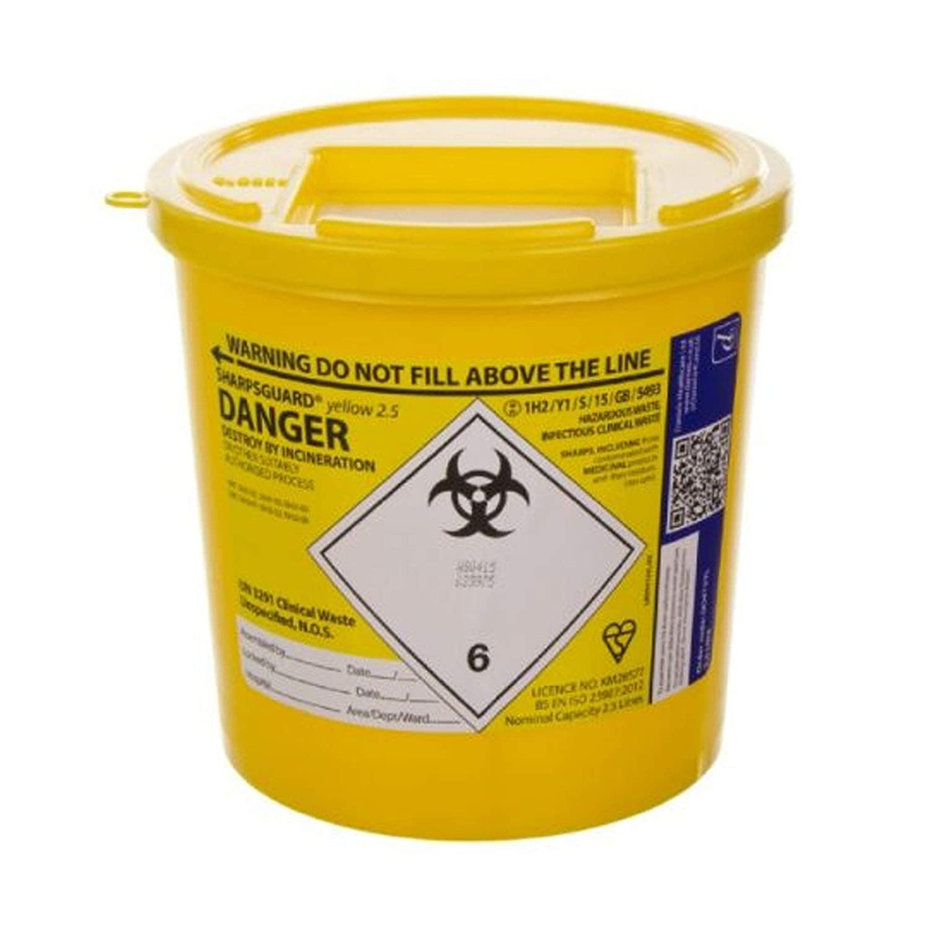
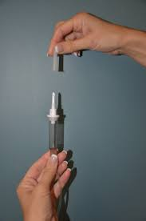
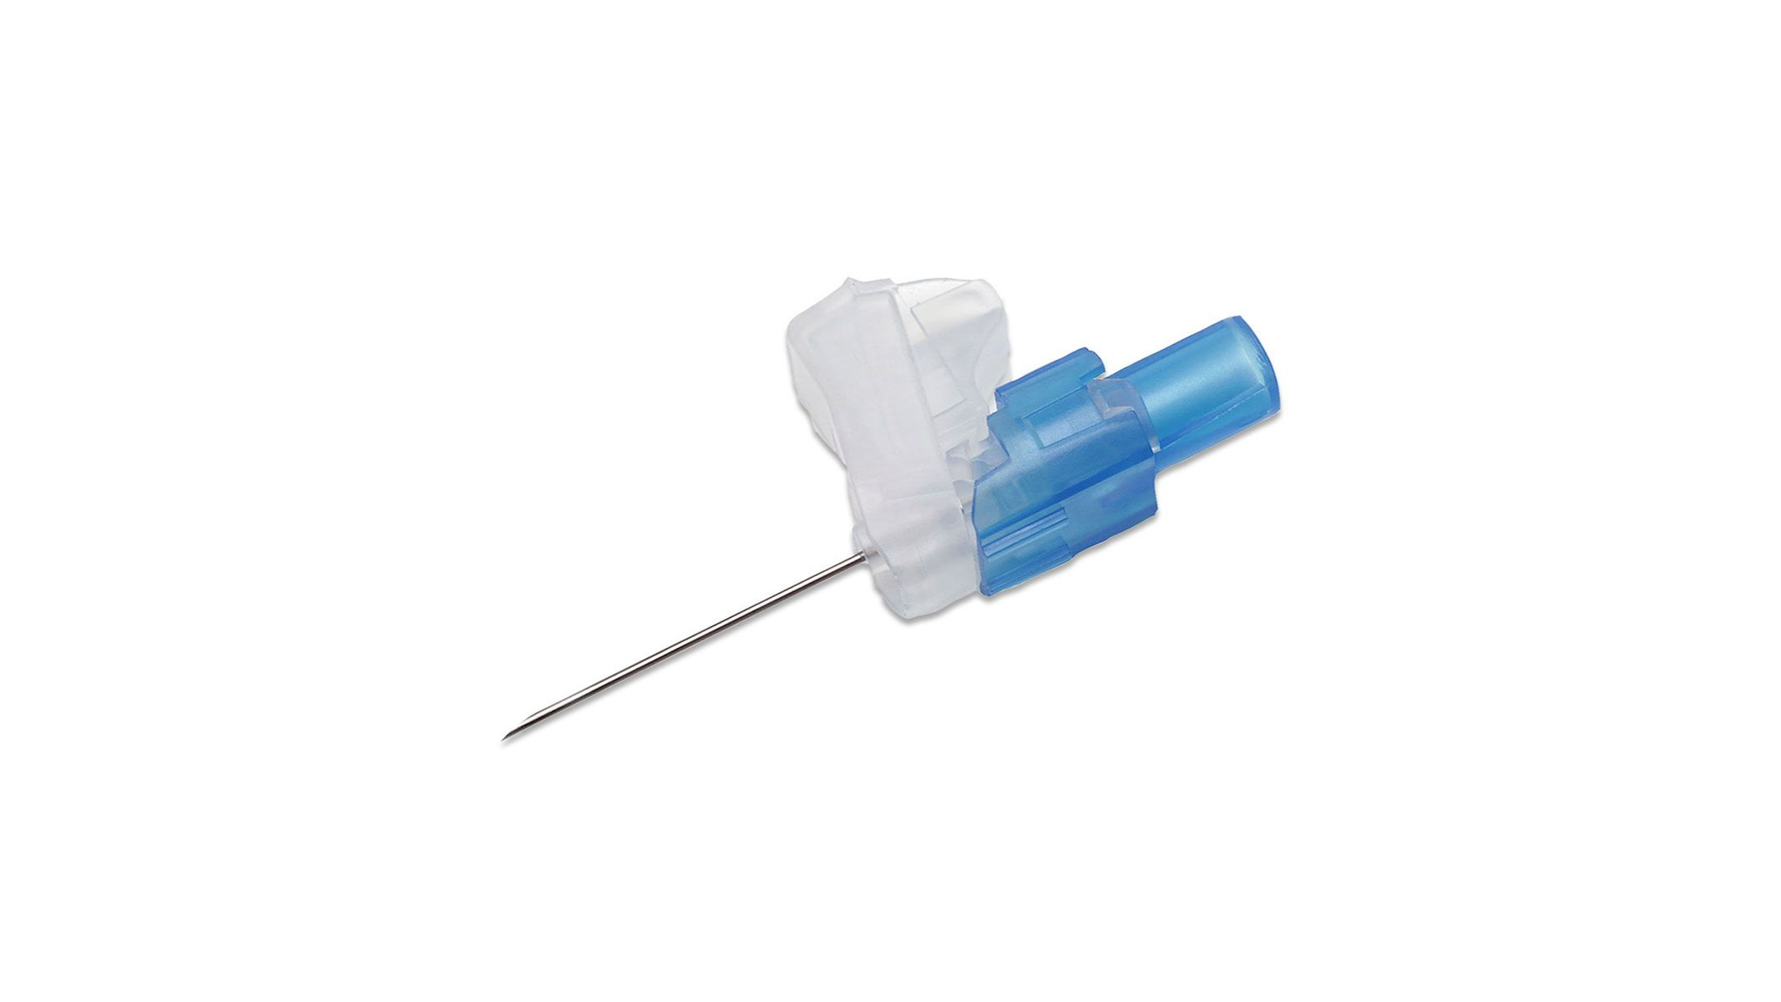
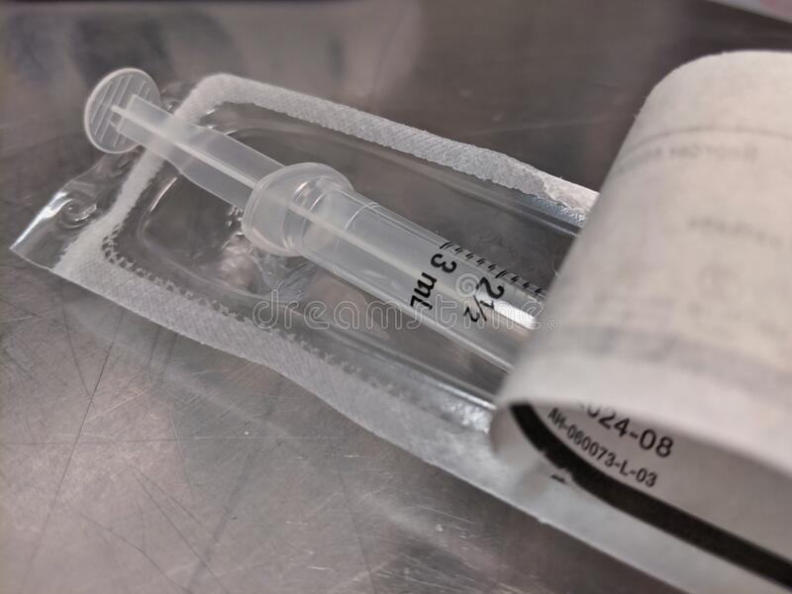
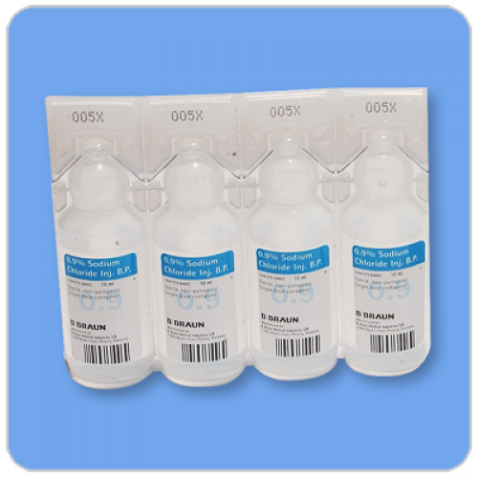
What Goes in the Sharps Bins?
YES PLEASE
NO THANKS
Needles
Butterfly needles
Inner cannula needles
Fluid giving set spikes
Scalpel blades
Lancets
Glass vials
Broken glass
Syringes
Fluid giving set tubing
Cannulas
Saline/water vials
Plastic packaging
Paper packaging- can be recycled
Metal scissors- can be reused/recycled
STOP! Please think where you
are putting your waste
Disposal of each sharps bin costs the School
£38 and has a carbon footprint

