Slide 1
Children’s Nursing Practice Update
Super Educator Conference 2021
Alison Taylor & Lisa Ford
University of Brighton
Notes:
This year's theme is assessment and supervision, particularly reflecting on the NMC Standards and PAD/OAR use across our courses. It will be a great opportunity to share good practice and problem solve some difficulties over the last 18 months and plan for the next year. There will be presentations on all the NMC courses, curriculum and planner updates, as well as a wealth of research and innovative practice updates taking place. This is an important opportunity for practice partners, course teams and academic assessors to collaborate and really drive forward practice that meets the requirements, supports our practice placement providers and enhances our students learning, supervision and assessment.

Slide 2
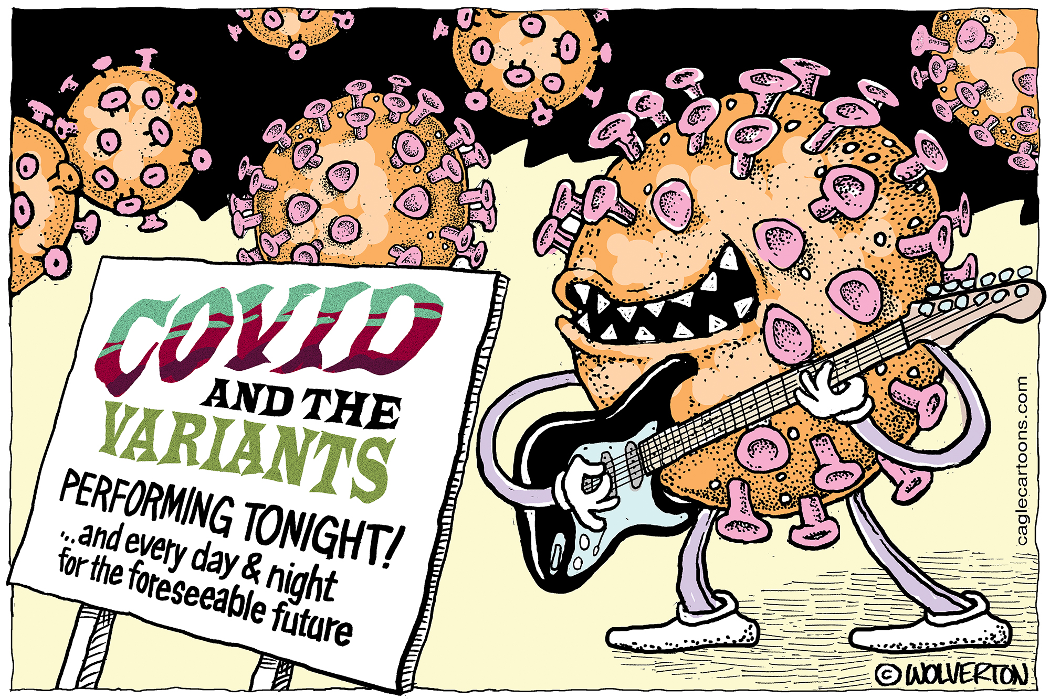
What a year…
Notes:
This and last academic year has been challenging for all of us, obvs practice staff and students, but academic and professional uni staff as well

Slide 3
Child field placement challenges
Placement shortage- creativity required!
Generic settings, e.g. primary care
Adult wards
Nursery placements
What have been the main challenges for you in supporting children's nursing students in practice?
Notes:
Quality Assurance in Placement Learning, Leaf/Podiatry, PEEP
Mentimeter here?

Slide 5
Nursery Placements
Innovative!
Year 1 students x 9
Five week experience in settings across Sussex
Allocated supervisor
PA from child academic team
Remote assessment
Feedback:
https://padlet.com/ljford/7df5dsjyiv0j5yto

Slide 6
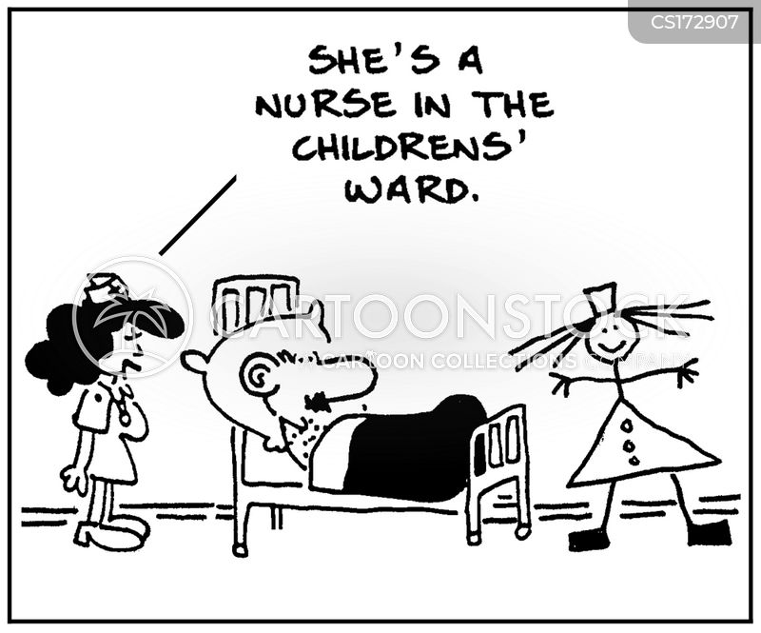
Practice experience
Students- what has been your experience?
What was it like to use the PAD and OAR?
What can we learn from this year?
Notes:
Practice experience different to what would have been but what can we take from it
Gaining feedback during the placement? Service user, peer feedback, communication record by a range of staff, record of working with practice supervisors
Any concerns regarding:
-practice understanding of PAD completion?
-completion of initial/mid or end point interviews?
-completion of proficiencies? Rationales?
-completion of episodes of care in this placement or in the next?
-completion of medicine management in this placement or in the next?

Slide 7
Child field guidance
Developed in November 2019 with introduction of new PAD
For Year 2 students initially
Updated December 2020, Year 3 version added
Notes:
Nov 2019- Sep 18 cohort were at beginning of Year 2 of new curriculum and PAD was brand new. Covid yet to hit!
Dec 2020- start of second Covid wave ahead of placements starting Jan 2021- first one of the academic year for Year 2 and 3 students
Year 1 students still not on placement till July 2021

