Slide 1
Ongoing Achievement Record (OAR)

Slide 2
Part 1 placement 1& 2
Ensure these parts are signed at the end placement (Part 1)

Slide 3
Part 2 placement 1 &2
YEAR 2 Ensure these parts are signed at the end placement (Part 2)

Slide 4
Part 3 placement 1& 2
Ensure
YEAR 3 Ensure these parts are
signed a the end of
placement 1 &2 (Part 2)

Slide 5
ongoing Achievement Record (OAR) year 2 & 3
PART 3 Ensure Medsafe and marks are entered
PART 2 Ensure Basic Life Support and Maternity Unit is completed

Slide 6
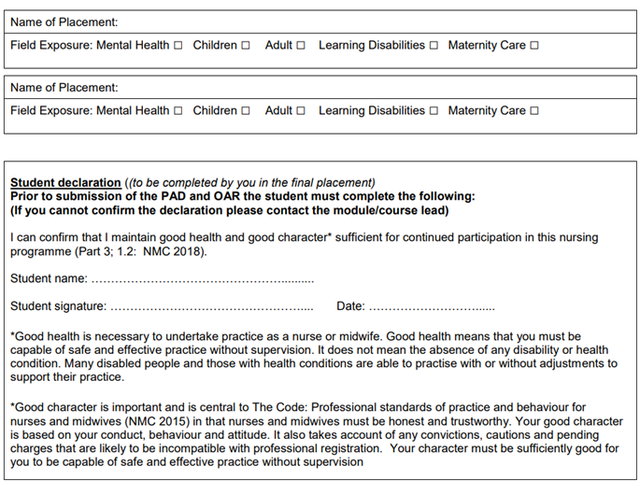
Year 3 final signoff in oar booklet
YEAR 3 Ensure these parts are signed at the end of placement
YEAR 3 Final Signoff by PA

