Slide 1


Group 13
P.R.A.D.S
Team Leader – Scott Griffin (20824063)
Health and Safety, and legislation – Ajin Antony (21839797)
Project Planning Lead -
Anthony Facey-Campbell
(20805775)
Product Design – William Freeman (21842785)
CAD and Simulation -
Mohamed Inshaf
Mohamed Ibrahim
(21843686)
Plastic Reclamation and Disposal System
XE500 Engineering Systems Presentation
University Of Brighton 2021/22

Slide 2
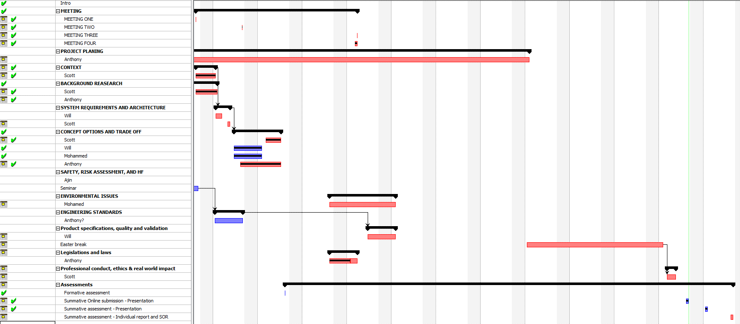
Project Planning and Meetings
Meetings – A Rough Layout
18/02/2022 – Background Research and Project Planning
25/02/2022 - User Requirements and System Requirements
04/03/2022 - Concepts, Health, and Safety
08/03/2022 – Justification of Subsystems and Architecture
11/03/2022 – Ethical Issues and Environmental Issues
15/03/2022 – Laws and Legislation
18/03/2022 – MoSCoW Deciding a Final Concept
25/03/2022 - Final Design Concept and CAD Modelling
02/05/2022 – Producing Presentation
06/05/2022 – Clean up

Slide 3


Context and Need
Need
A system which efficiently collects plastics and other foreign materials from the surface of the ocean from the eastern side of the great pacific garbage patch

Slide 4
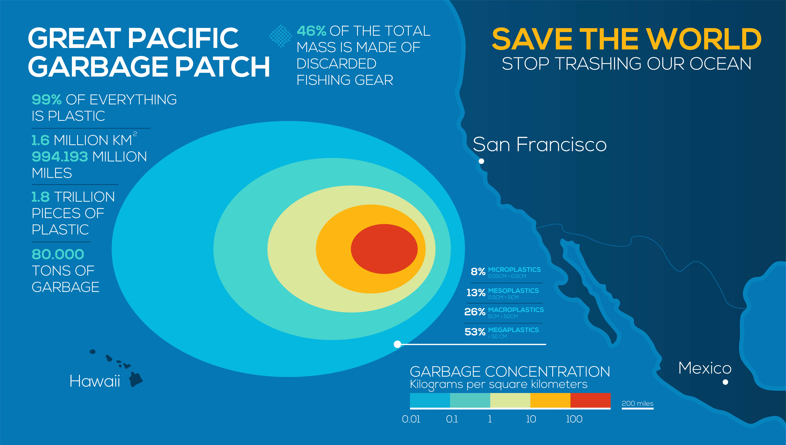

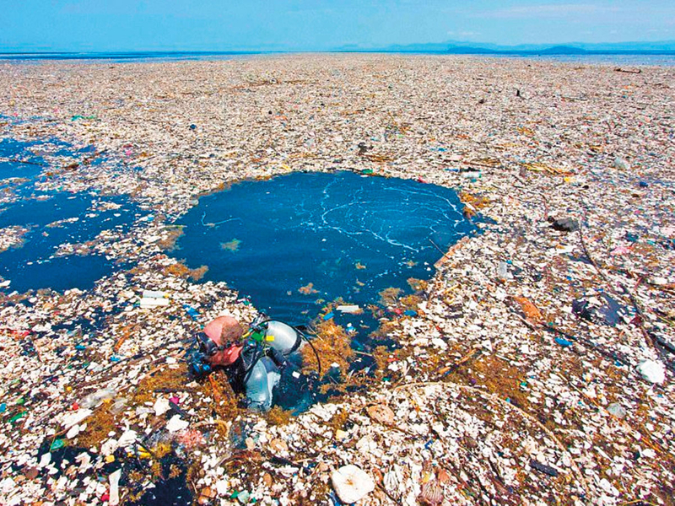
Geographical Area of Concern.
Great Pacific Garbage Patch – South Gyre
- Largest collection of plastic debris present in our oceans
- Covers an area of 1.6 million square kilometers (3 x the size of France)
- Shape of patch is constantly in flux
- Requires a lot of team/organizations to manage area.
- Majority of Patch is made up of Floating (surface) Plastics.
- Estimated 80,000 Tonnes of Plastic
- Only predicted to increase in size
- Off the coast of California
Source: The Ocean Clean Up

Slide 5
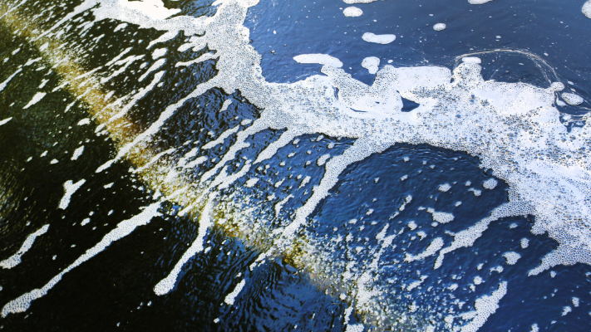
Background Research – Why is this system Important?
Issues and impacts on humans and wildlife:
Ecosystems are harmed by dangerous microplastics formed when the larger fragments breakdown (macro-plastics). Due to degradation from the sun, marine
Bio-accumulation – from PBT chemicals (Persistent Bio-accumulative Toxic)
Where plastic travels through the food chain. Small marine animals feed on the plastic
Which, in turn, are fed larger animals, and then ends up in the human food chain.
The macro-plastic can blot the light from the surface -> Phytoplankton cannot photosynthesize, and this can impact the local ecosystem.
Entanglement of marine life -> swimming animals collide with the floating ghost nets, becoming trapped and cannot free themselves.
Ghost nets -> abandoned nets from fishing boats, often marine animals cannot escape them because they are invisible in dim light
Plastics can wash ashore and cause ecological/economical damage to a natural beach

Slide 6
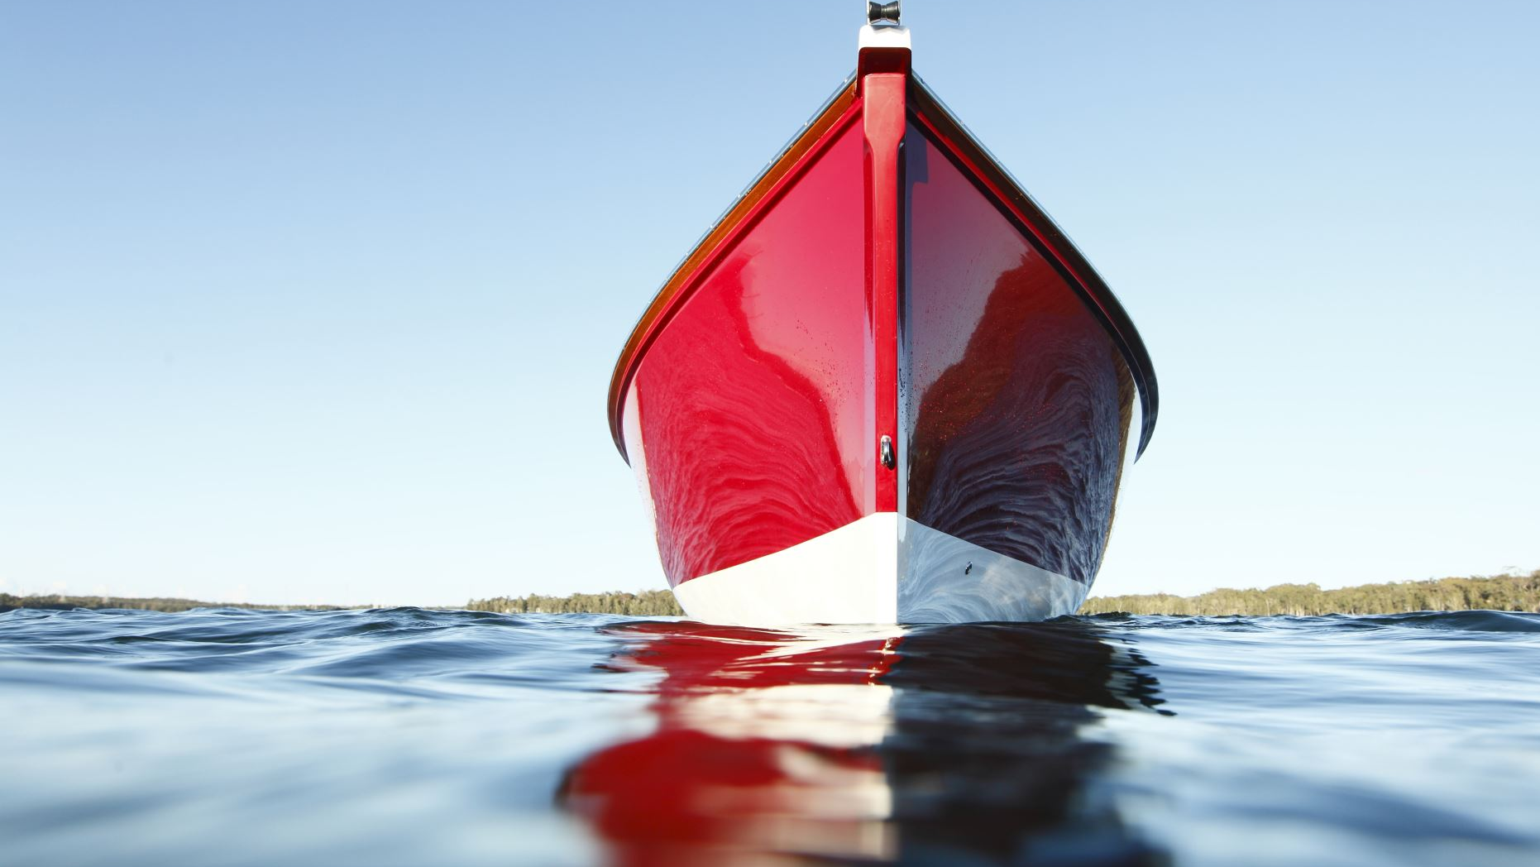
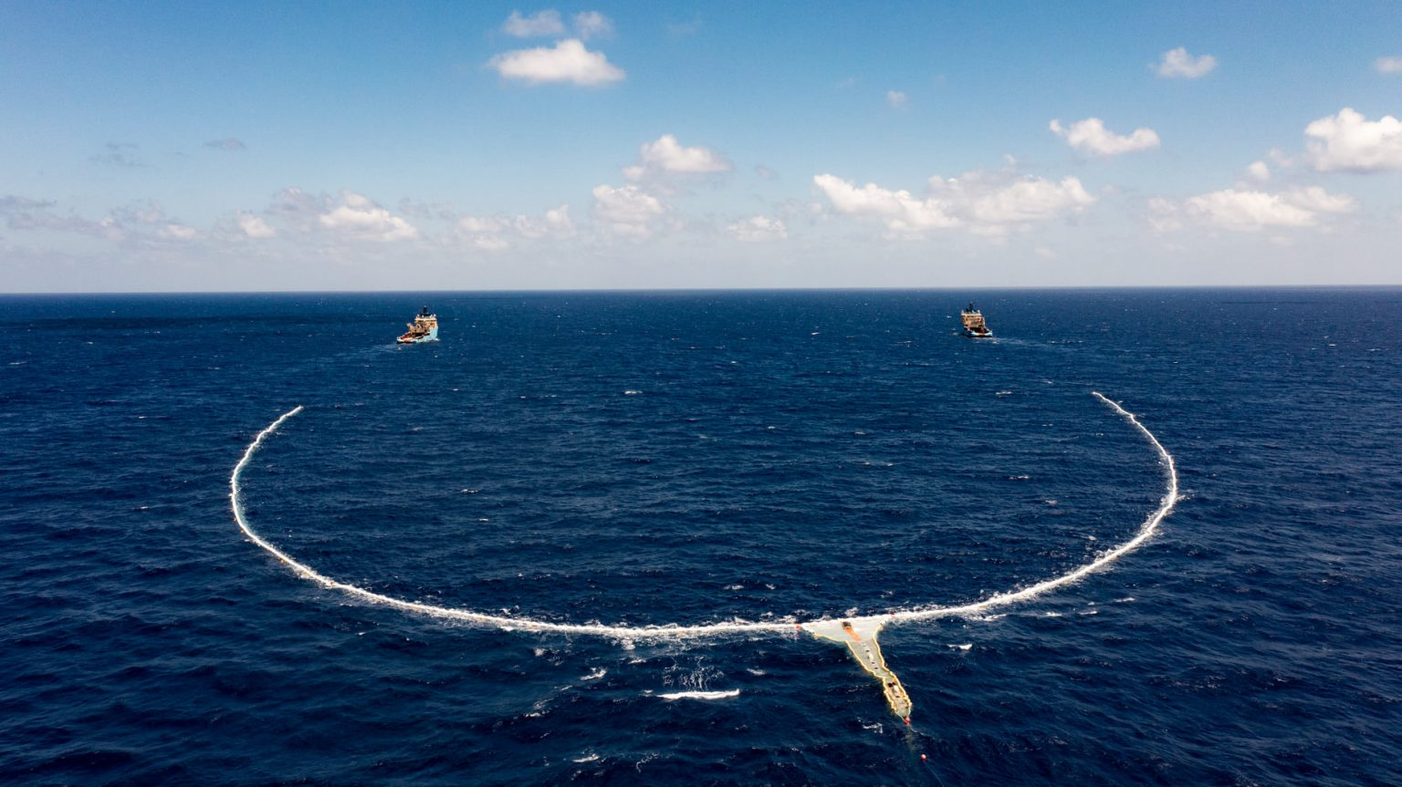
Concepts Already In Practise – 002 systems “Jenny”.
Ocean Clean Up Company (Jenny):
800m long netted barrier, 3m deep.
-Fully open underneath, enables fish to vacate safely
-Floatation devices to retain the nets form
-Both ends of the barrier linked to separate tugboats.
-1.5Knots (2mph) -> speed
-Plastics is swept across the ‘wings’ into a central collector bin (retention zone)
-When the bin is filled (approx. week), the tugboats move together
-Jenny barrier is detached from one tug and reconnected to the other
The free tug travels behind the barrier draws the plastic in from the retention zone to where it is sorted on dec
Before, being offloaded at the nearby port
Source: The Ocean Clean Up

Slide 7
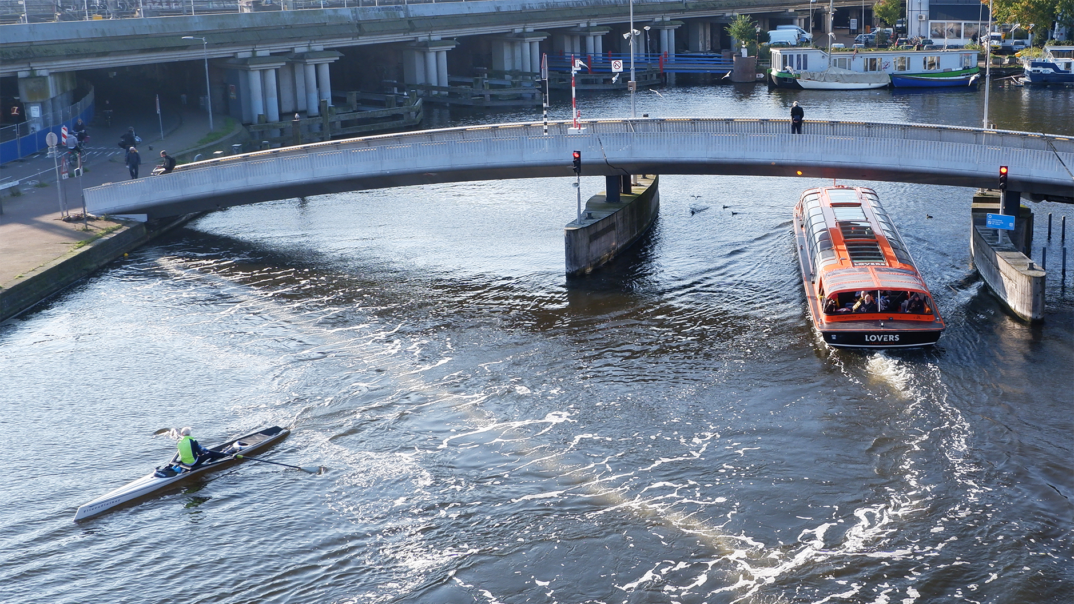
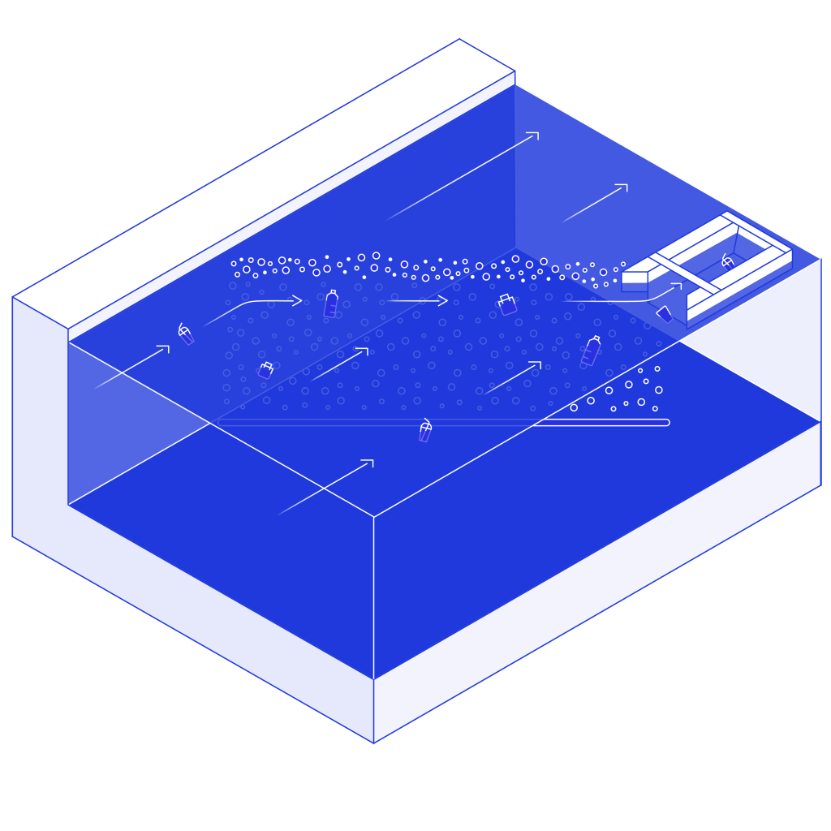
Concepts Already In Practise – Great Bubble Barrier.
The Great Bubble Barrier:
Creates a non invasive barrier of bubbles that doesn't impact Lane traffic or Local wildlife
Deployed on the bed of a river, has extensive reach, covering from water bed to surface.
Directs the debris along a curtain of air, also making submerged plastics float.
Directed Plastic is collected in a collection bin and scooped every few days.
Increases the level of dissolved oxygen on the water Positively effecting the wildlife.
Operates 27/7
Versatile and can be deployed in a wide range of location with minimal effect to infrastructure.
Source: The Great Bubble Barrier

Slide 8
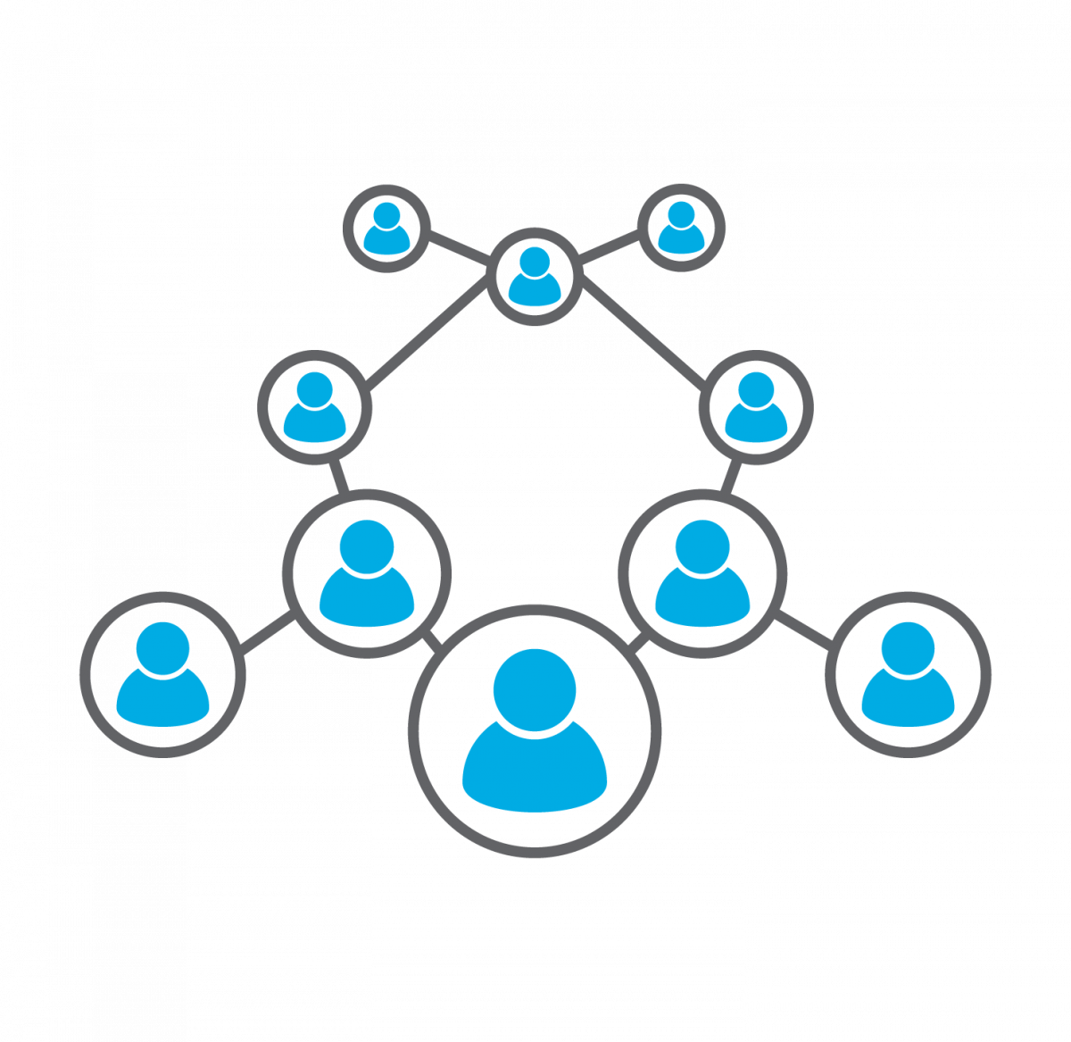

Stakeholders and Main Functions
Stakeholders
Environment body – ecosystems
People operating the system
People manufacturing the product
Trainers (if the system is complex and requires you to be taught)
Port officials and Life-guards
On shore companies used where the plastic is being offloaded
Local Port operations Impacted by Large ship Movements
Functions
The system needs to collect plastic and foreign materials from the ocean
The system needs to be able to hold plastic and foreign materials
The system needs to be able to empty the waste and foreign materials

Slide 9
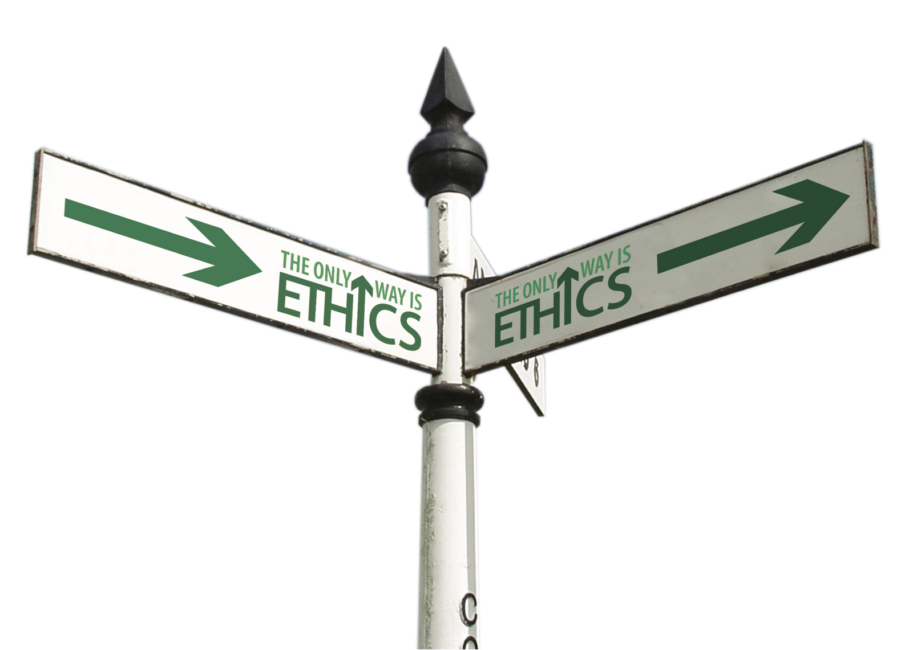
Ethical Issues of a system
Those who operate boat/system require a place of rest if they are going to be out at sea for longer than a day
Those who operate boat/system need training to control the system properly and with minimal risk
Disposal of the collected plastics and foreign materials – if we dispose of them incorrectly then we could end up throwing them back into the ocean, furthermore, if we dispose of them incorrectly then we could be causing more damage.
We need to make sure that we aren’t harming marine life – we could break laws by harming them
Boating laws need to be considered – again we could be breaking laws by sailing in certain areas
World sailing code of ethics needs to be followed [Available @ https://www.sailing.org/tools/documents/2019CodeofEthicsPostMidYear-[25097].pdf ]
Safeguarding
Lifeboats and other safety equipment are required on the boat to either prevent risks or to keep people safe when a hazard occurs
Anyone manufacturing the system/device/boat should be trained to remain as safe as possible
Anyone manufacturing should have safety equipment

Slide 10
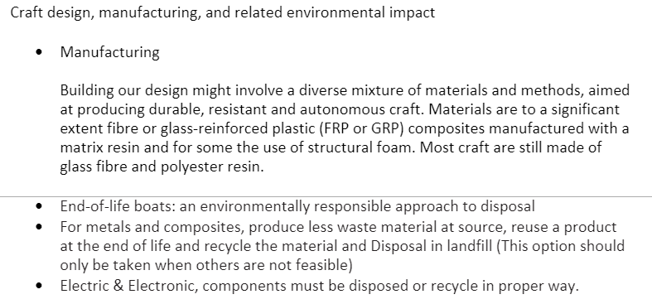
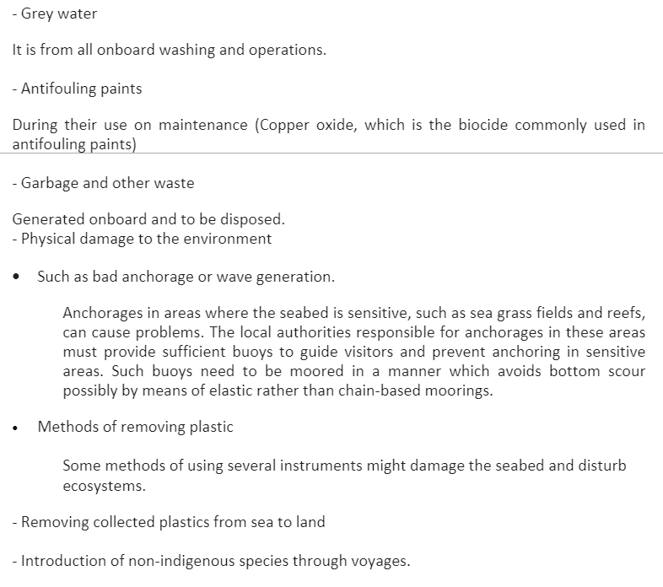
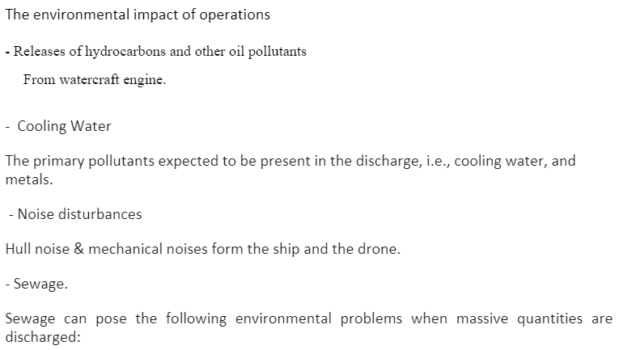

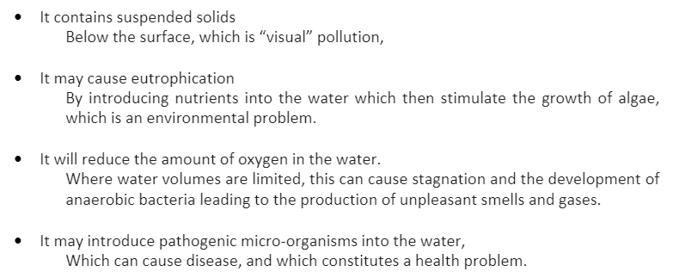
Environmental Issues of a system

Slide 11
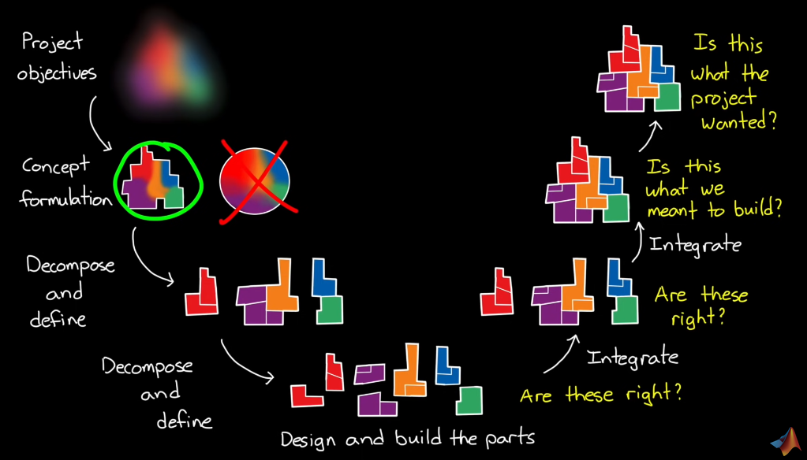
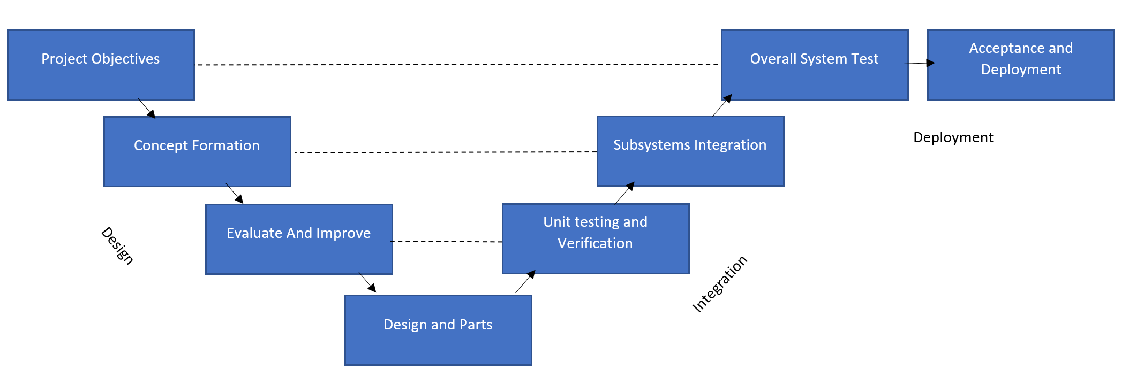
Systems Engineering
V model Architecture
V-model Stages used:
Project Objectives – Needs, Specifications and all defined limitations considered from the stakeholders and other shareholders.
Concept formulation – What it says on the tin!
Evaluate and Improve – Refining the Ideas and evaluating the solutions proposed down to a final solution.
Design and Parts – Breaking down the solution into requires factors and researching costs and constructions.
Unit testing and verification – Confirm it is right, adheres to needs
Subsystems Integration – Evaluation of subsystems and testing of operation
Overall Systems test – Penultimate testing and verification
Acceptance and Deployment – Completion/Final approval for deployment.
Source: MATLAB Systems Engineering

Slide 12


System Requirements
(MUST)
System Requirements
Cover a 10Km Area of earth’s oceans
Remove Micro Plastics at minimum
Contain a defined amount of collected detritus back to mainland.
Function in ALL defined operational weather conditions
Autonomous or Semi-autonomous.
Collect a minimum of 2 metric ton of material.
Operate as much as possible on renewable Fuel source (e.g. Solar, wind, etc.)
The system must be operating (battery life, fuel, etc.) for more than 1 hour
The system needs an entry point that needs to be bigger than a 19.6-ounce bottle and no bigger than a 1-liter bottle
The system must be able to collect and unload plastics and foreign materials
The system needs to prevent water ingress

Slide 13


System Requirements
(Should & Could)
Minimise Environmental Impact for fabrication.
Repurposing of large vessels e.g. Cargo ships
Materials locally sourced
Process Waste at sea
Compress Plastics for more storage capacity
Disposing waste appropriately at port
Self-recycling on ship
Adhere to all appropriate Californian recycling Legislation
Energy Storage regulations - PC
The system needs to move at a maximum speed of 15 knots
MARPOL Annex V – Garbage management
The system should have lights if it should be used at night, in dark areas or underwater
The system should discourage animals from coming close to it
Have fully developed Presentation prepared by 13 may
Have completed all design related tasks by 13 may

Slide 14
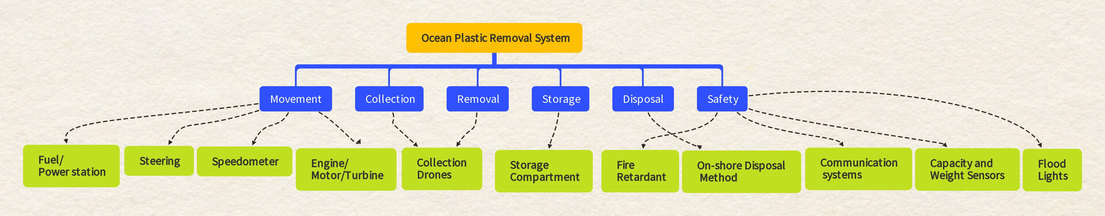
Justification of Subsystems – Plastic Reclamation and Disposal System (PRADS)

Slide 15
Concepts
Mohamed’s Proposed Final ideas
Concept Idea
A floating machine which sucks the sea/river water though one end and collect the plastics push the water though the other end. It can be design in the shape of a tube placed in vertical. We can make multiple of these machines to float in the middle of the ocean.
In addition, we can build a common storage once every machine collects and then it can store the storage.
These machines and the system can be powered by floating solar panel.

Slide 16
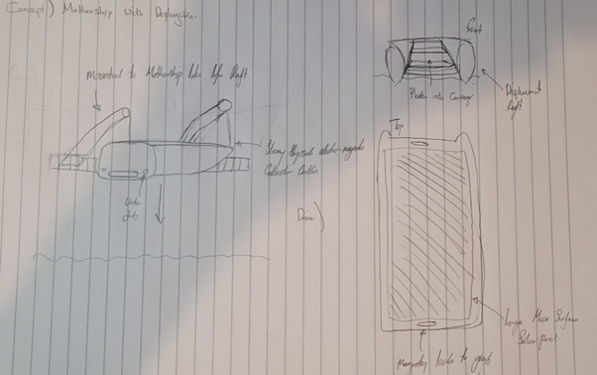
Concepts
Will's Proposed Final Idea
Solar automatic collection drones, deployable from a "mother Ship”, The automatic collectors will collect surface to low surface plastic via a conveyor system. It'll carry a determined amount then return to the mother ship to offload and continue.

Slide 17
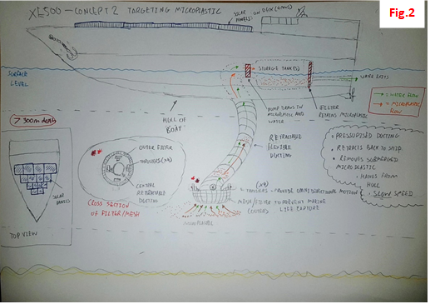
Concept
Anthony's Proposed Final Idea
A filter that is lowered vertically down from a ship hull via flexible, pressurized (extendable/retractable) pipe greater than 300 m
Thruster (x4) arranged around the circumference of the intake, enables omnidirectional motion of the intake -> ROV?
In the ship microplastic is stored in internal storage tanks filtered from the water
Excess water exits through a port in the hull
Ship is renewably powered via Solar panels could possibly also use electrolysis of seawater to make hydrogen such as the 2017 Energy Observer

Slide 18
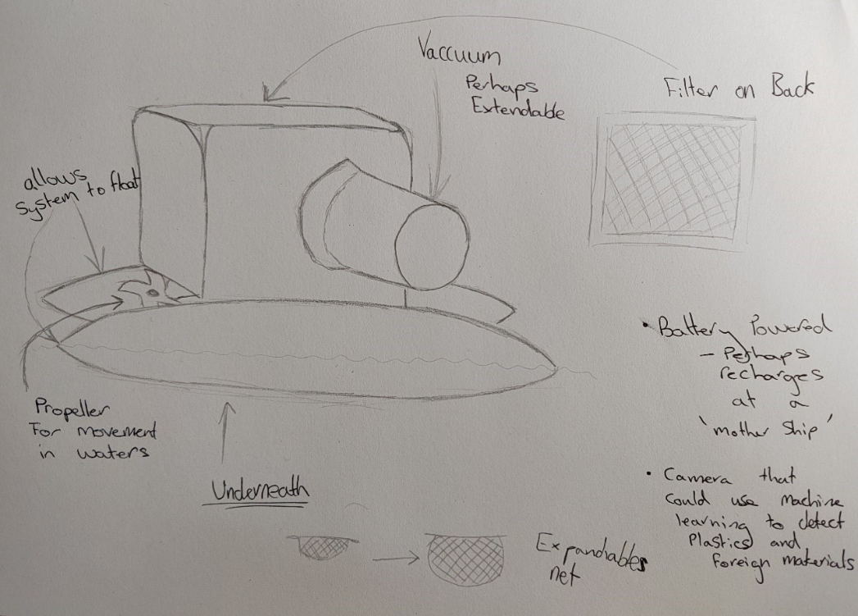
Concept
Scott's Proposed Final Idea

Slide 19
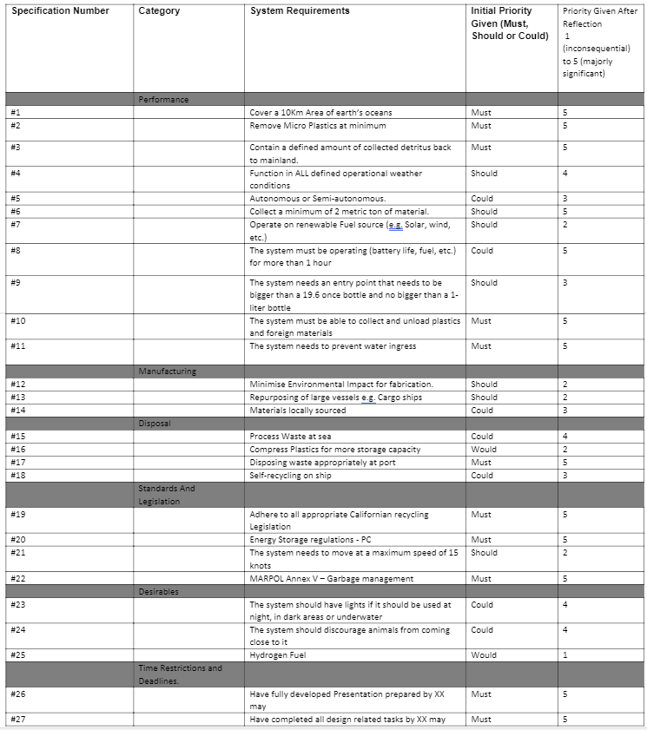
Deciding a Final Design
(MoSCoW)

Slide 20
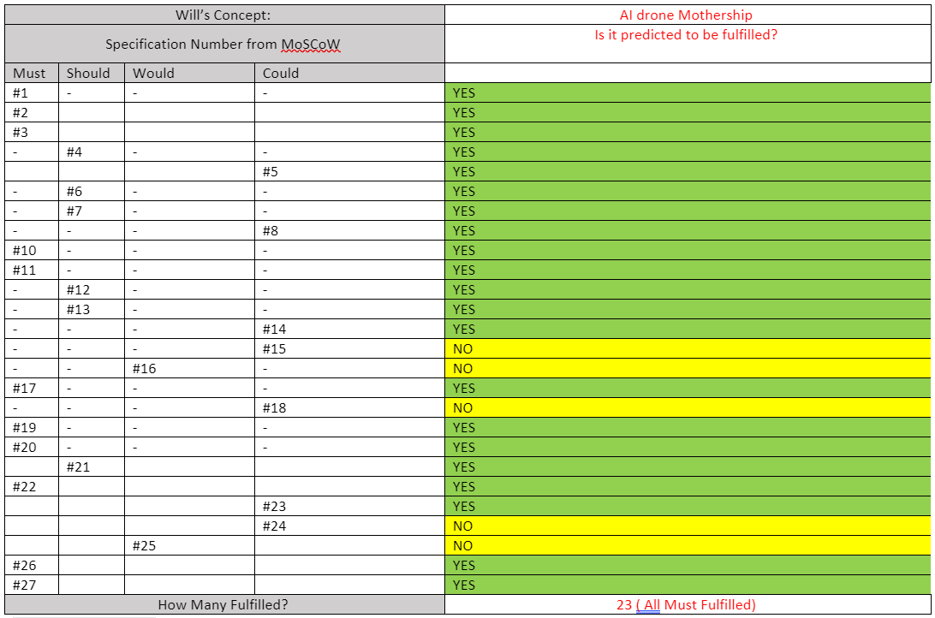
Deciding a Final Design -
MoSCoW Specification Fulfillment

Slide 21
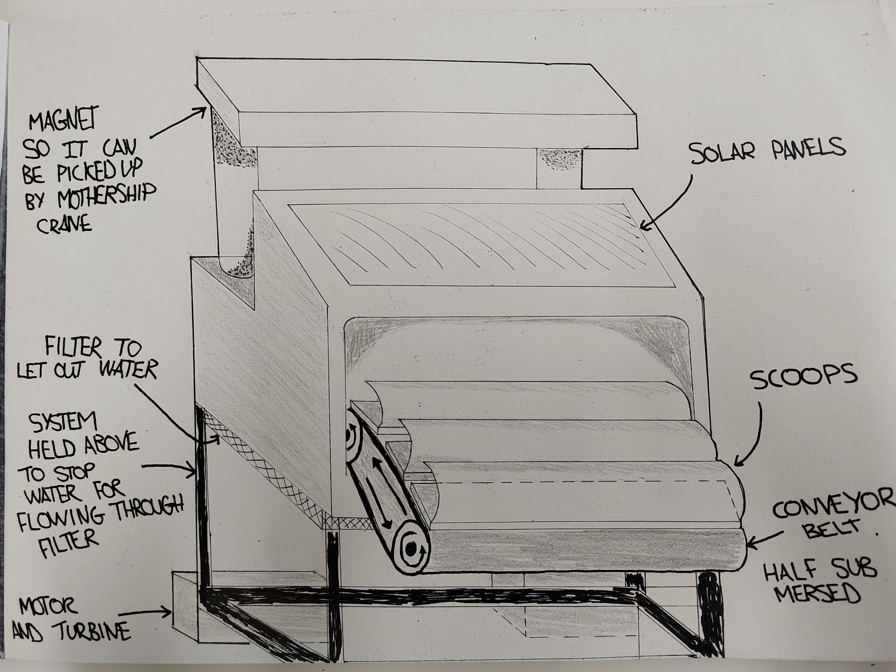
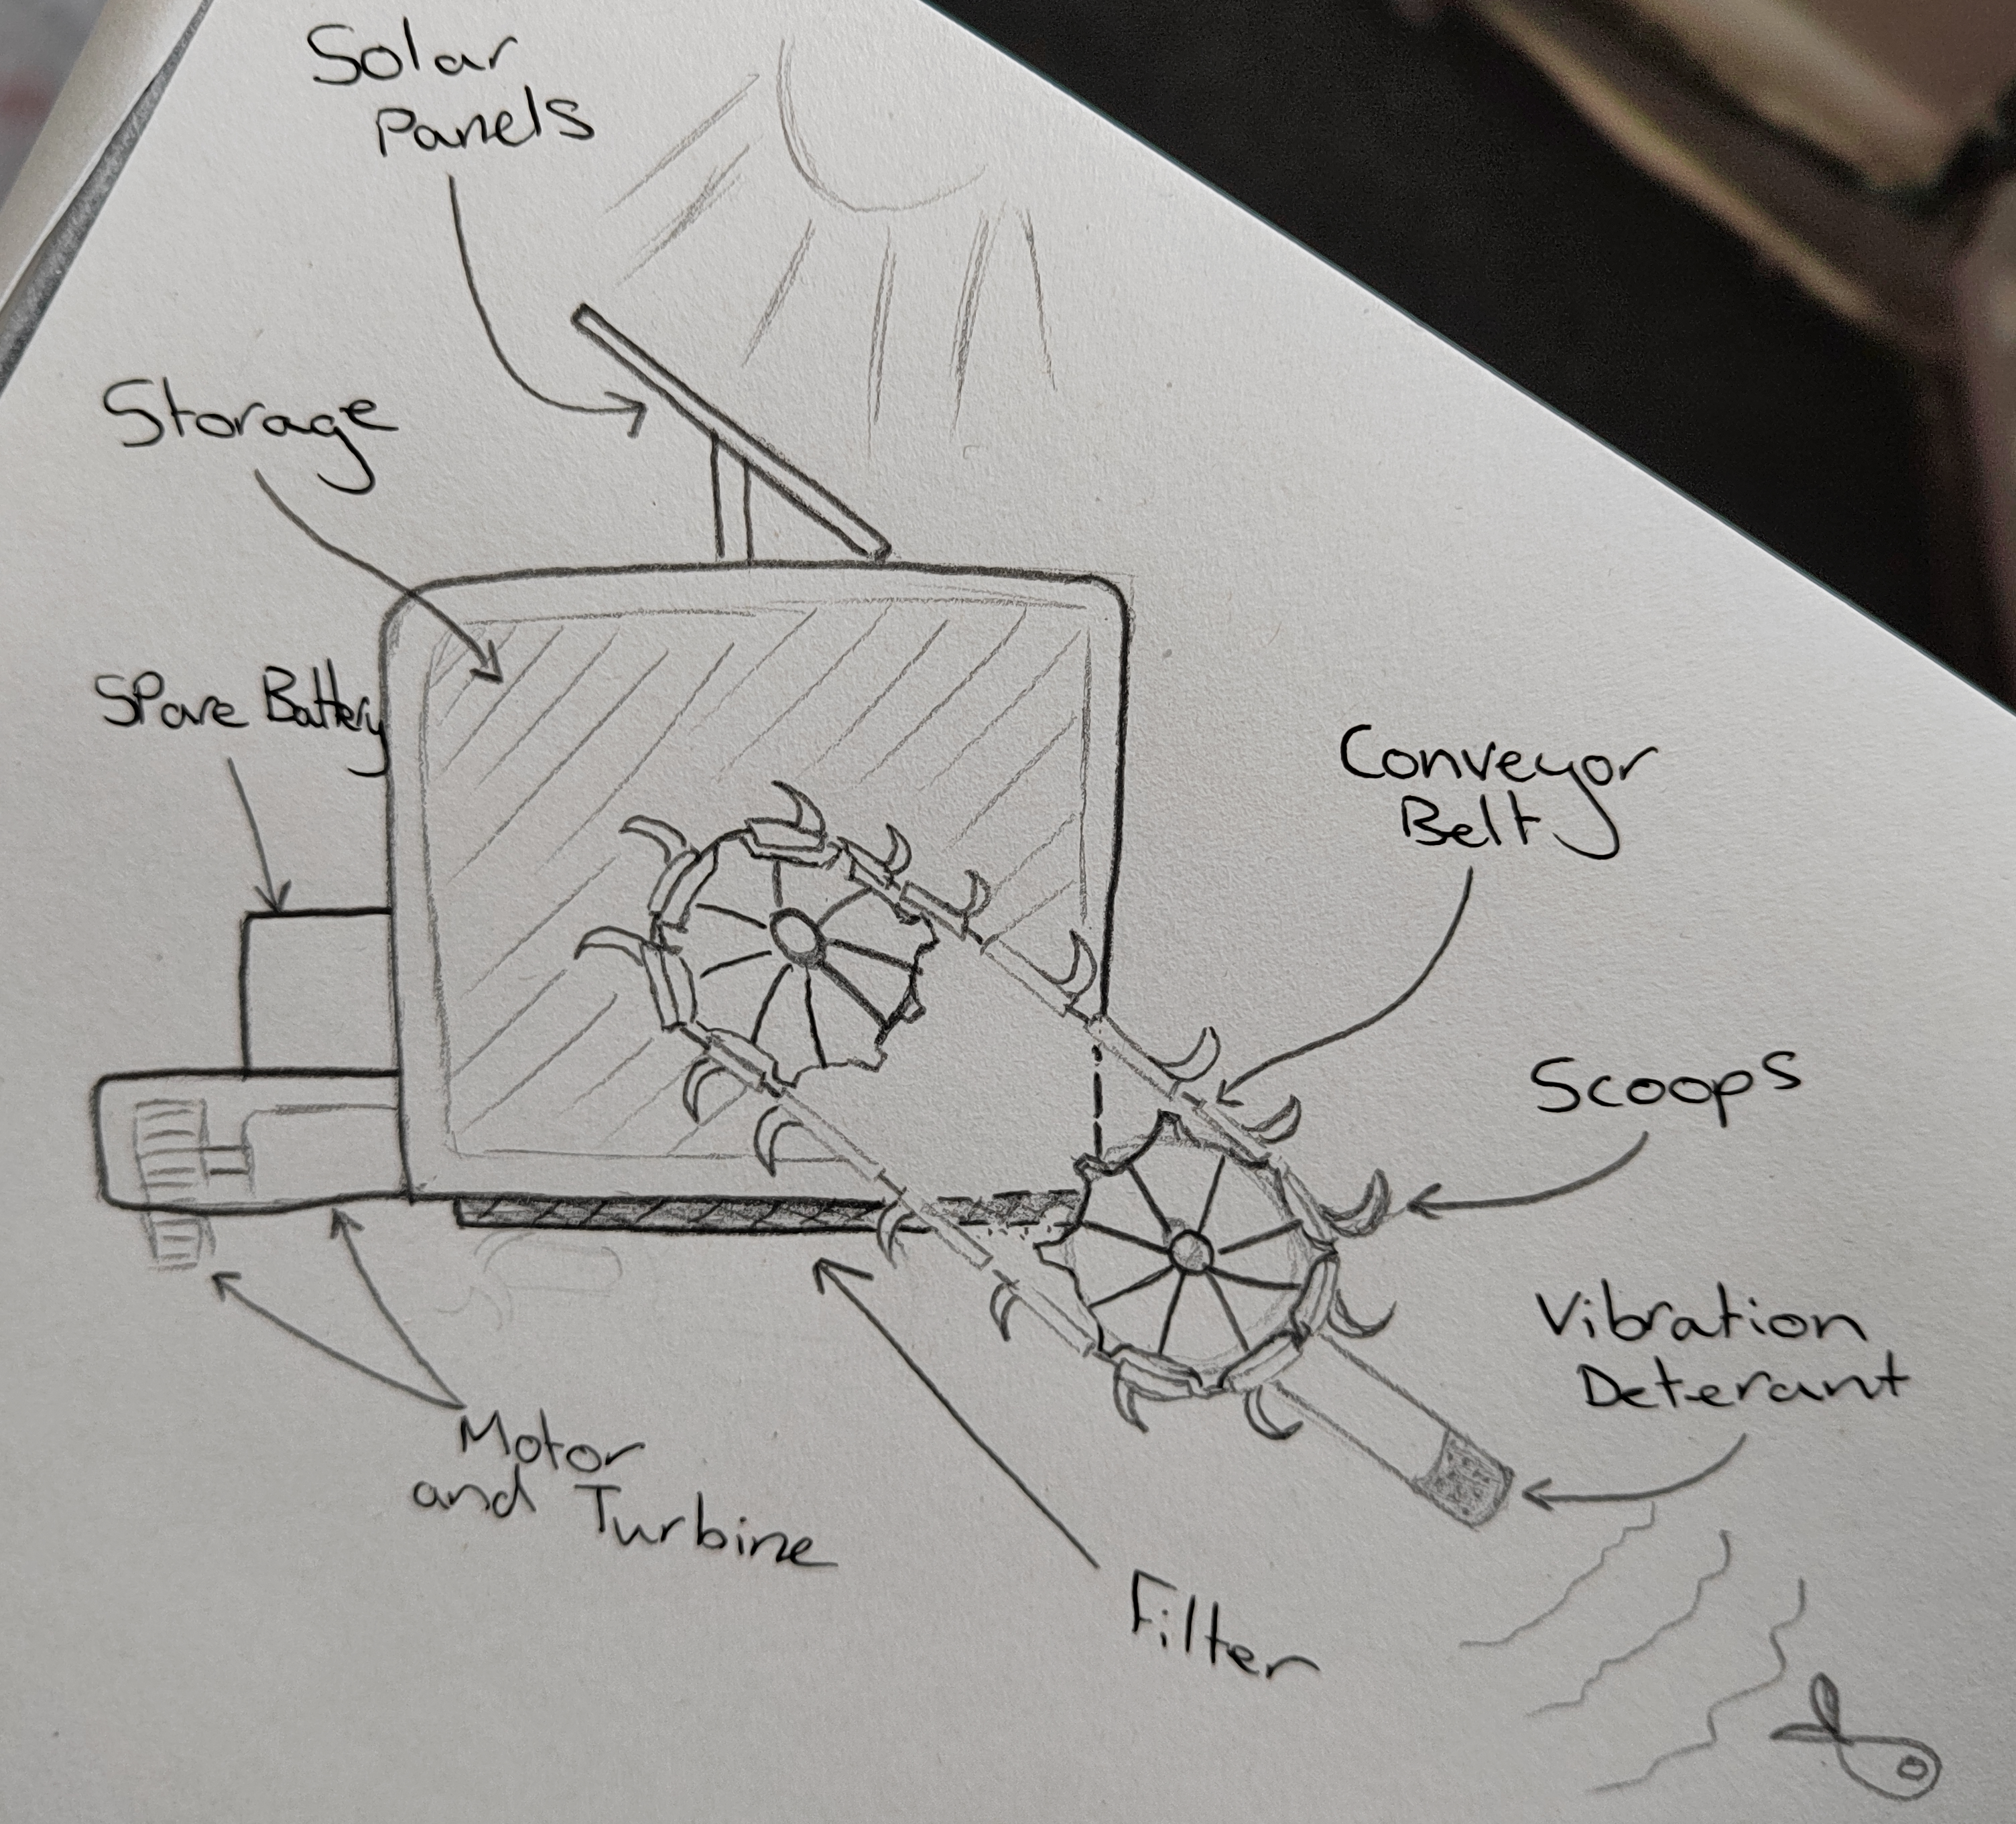
Final Concept Drawing

Slide 22
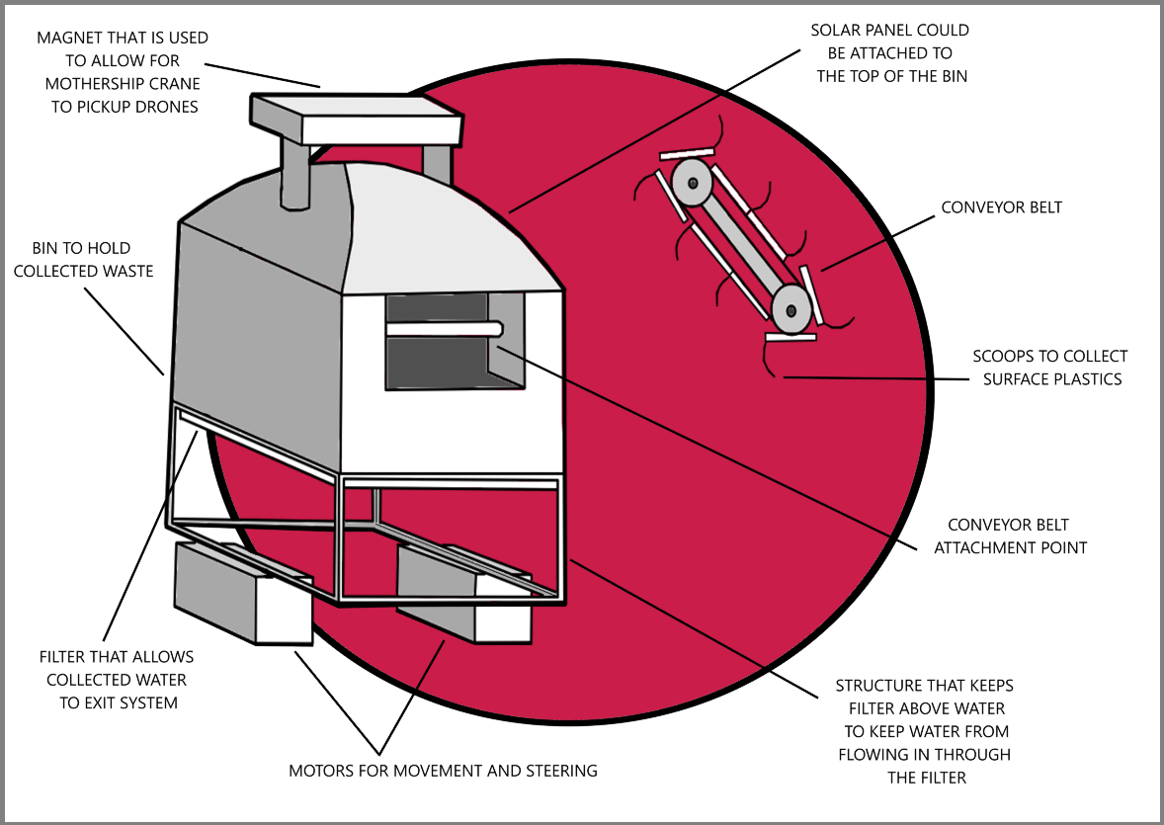
Digital Concept

Slide 23
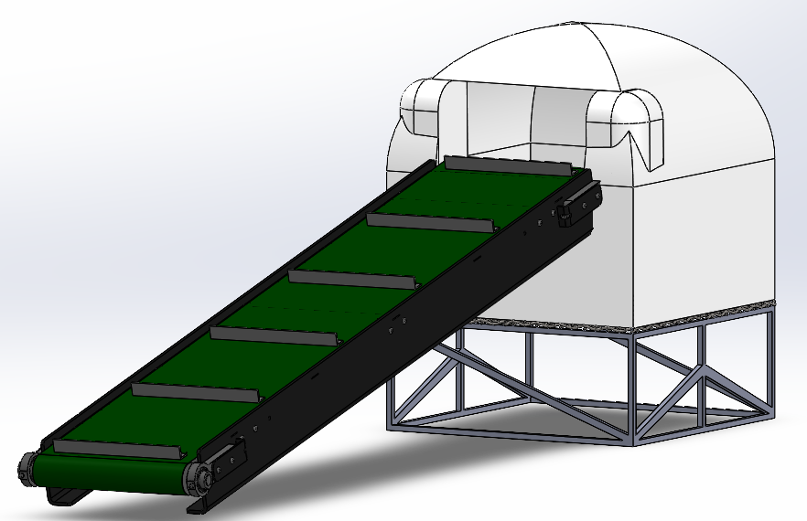
CAD Model

Slide 24
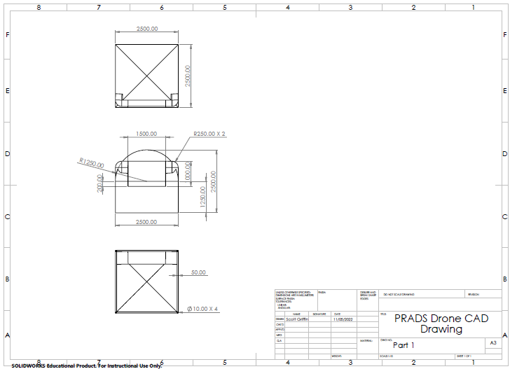
Engineering Drawing

Slide 25
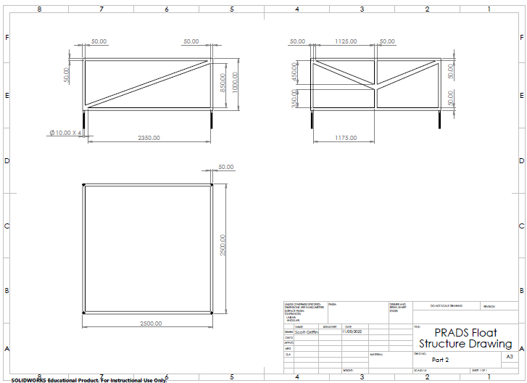
Engineering Drawing

Slide 26
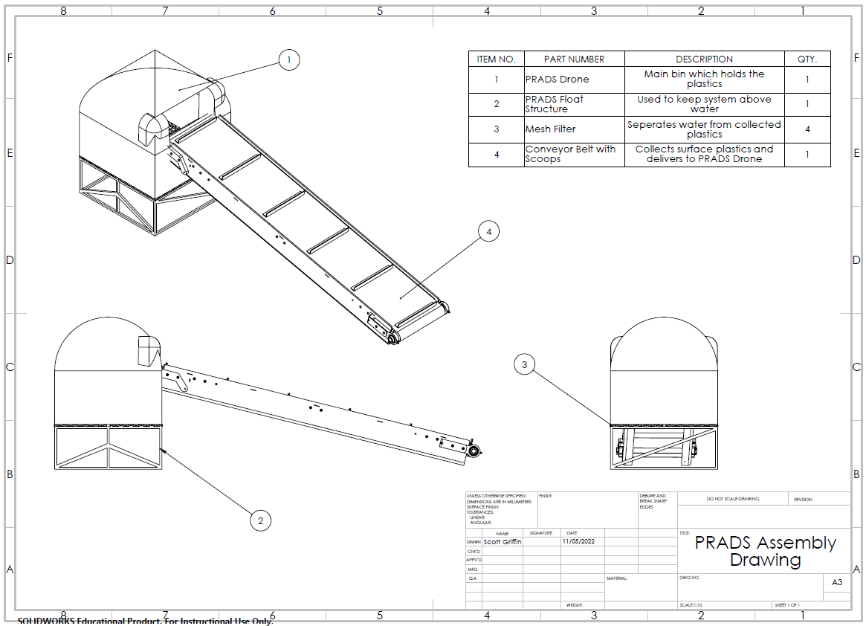
Assembly Drawing

Slide 27
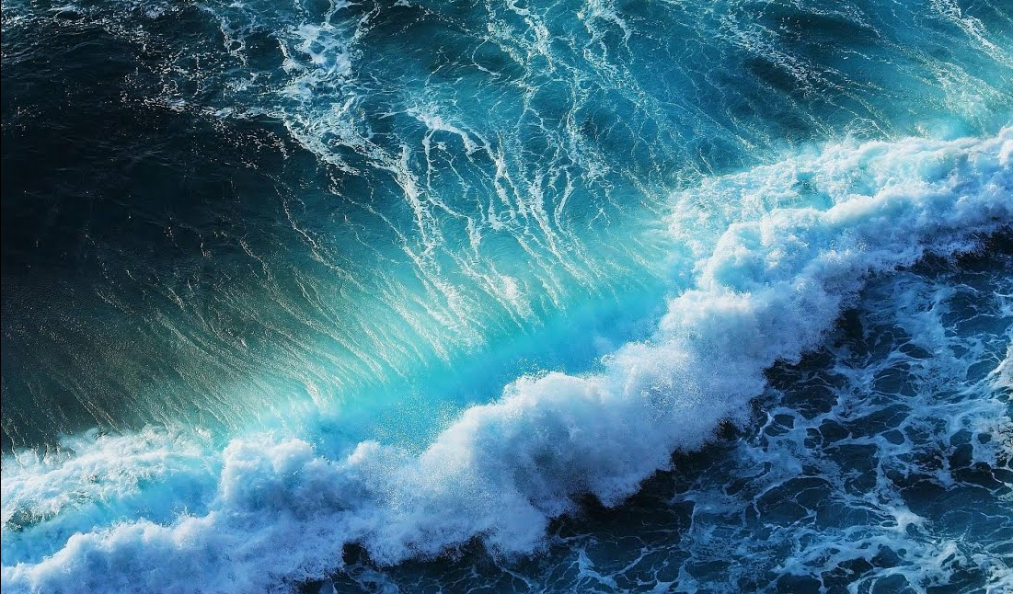
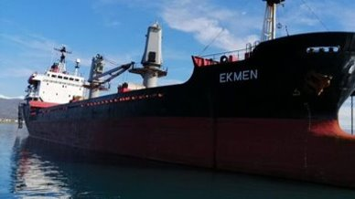
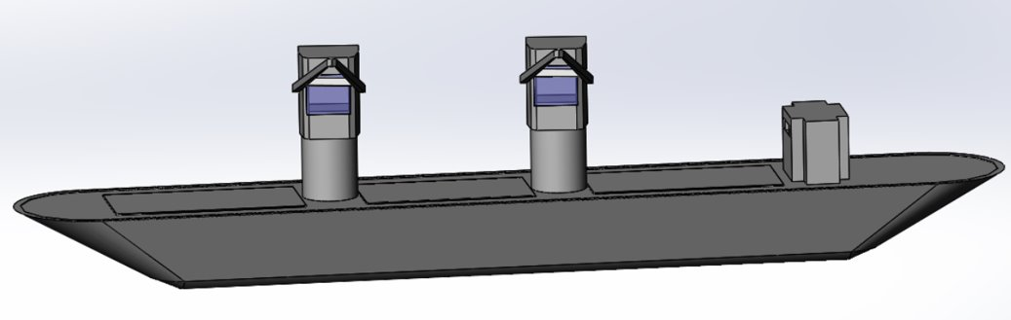
SHIPS SPECIFICATON​​
Class Society | Nippon Kaiji Kyokai
LOA (length overall)​​ | 105.5 m​​
Beam | 16.8m
Ship type​​ | Balsa cargo ship ​​
GRAND TOTAL(CAPACITY)​​ | 312112 cb.ft​​
HOLD 1​​ | 89735 cb.ft​​
HOLD 2​​ | 110888 cb.ft​​
HOLD 3​​ | 103755 cb.ft​​
DIMENSIONS​
HOLD 1​​ | L: 24m W: 16.8/16.8m H: 7.6m
HOLD 2​​ | L: 24.5 m​​ W:16.8/16.8 H:7.6 m
HOLD 3​​ | L:24.5 m W:16.8/10.6 m H: 7.6 m​​
Safest Cargo capacity | 85 Metric Tonnes
ENGINE GENERATORS​​ | Man B&W 5L35MC / 3800 HP 2794 kW​​ 3* Yanmar S 165 (L) 240 kW​​
CRANES​​ | 2 sets Electro- Hydraulic driven​​ SWL(Safe working Load): 15mtons​​
Chosen Ships Specifications

Slide 28
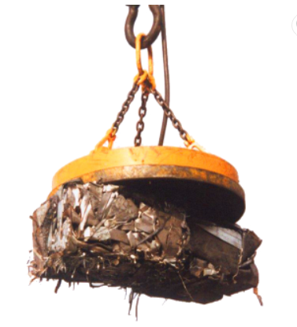
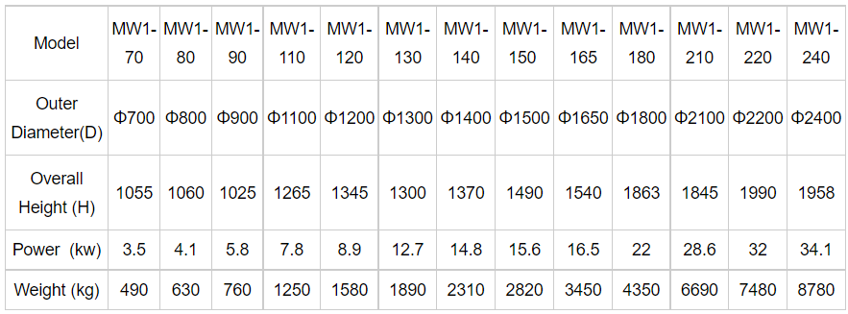
Magnet
https://www.alibaba.com/product-detail/Permanent-magnetic-lifter-Steel-Scrap-Circular_62362833817.html
We are using the 1400mm Diameter Magnet

Slide 29
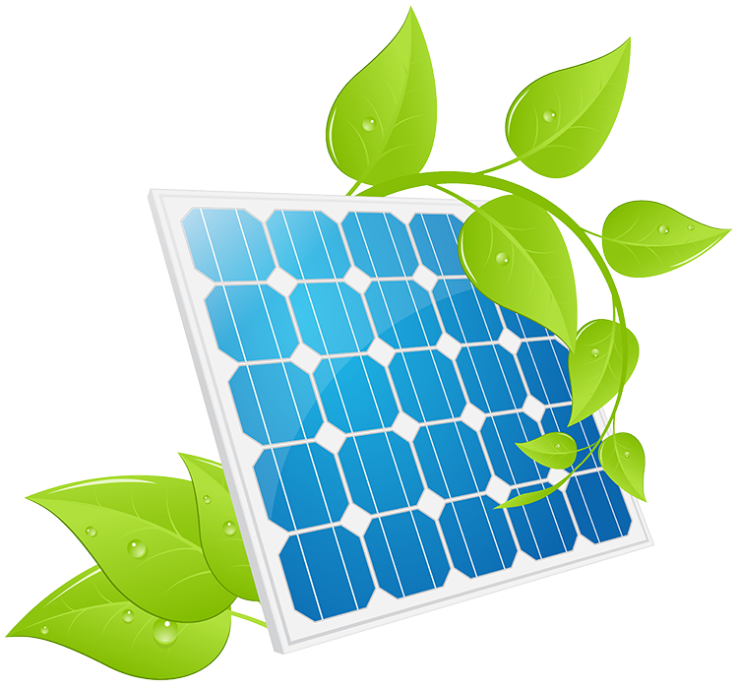
Drone Power and Considerations
After exploring the power capabilities, it came to light that a small change to the system would be more efficient and cost effective.
Established Solar Options:
Monocrystalline Silicon cells – Highly efficient cells, very costly.
Polycrystalline cells – Cost effective, but less efficient
Thin film – Low Power, Low cost, Bendable to surfaces.
New Solar Breakthroughs:
Perovskites (New Thin Film) - 100 times the power to weight capabilities of conventional Solar cells (Silicone cells). Printable, and surface paintable. Current market contender for mainstream development.

Slide 30
Health and Safety
Hazard | Description | How do you mitigate the risks? | Hazard Severity (1-5) | Likelihood of occurrence (1-5) | Risk Rating
Risk of being crushed (e.g. by heavy machinery, from offloading plastic netting at port) | Safety guards , belts and pulley | Regularly maintaining and checking machinery | 4 | 4 | 16
Drowning – in rough sea | Falling overboard | Lifejackets, Lifebuoy rings etc. | 4 | 3 | 12
Corrosion of metal components at sea | Damage to supporting decks e.g. Galvanic corrosion (occurs between dissimilar metals, electro chemical | Apply coatings on hull part Using sacrificial anodes | 3 | 5 | 15
Fire | Short circuit overheating engine ,fuel leak | Flame detectors , Heat detectors , Smoke detectors | 3 | 4 | 12
Turbulent seas | Violent storms, strange changes in ocean topography make vessel navigation unstable | Real time data access, Transparency measures , Responsive balancing | 3 | 4 | 12
Likelihood of occurrence
Remote (almost never)
Unlikely (occurs rarely)
Possible (could occur, but uncommon)
Likely (recurrent but not frequent)
very likely (occurs frequently)
Hazard severity
1 – Trivial (e.g. discomfort, minor bruising, self-help recovery)
2 – Minor (e.g. small cut, abrasion, basic first aid need)
3 -moderate (e.g. strain, sprain, incapacitation > 3days)
4 – serious (e.g. fracture hospitalisation >24 hours, incapacitation >4 weeks
5 – Fatal (single or multiple)

Slide 31
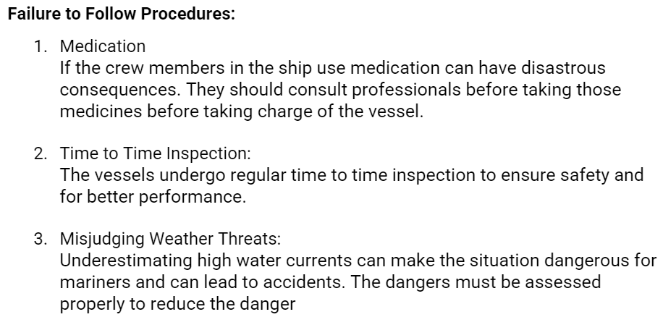
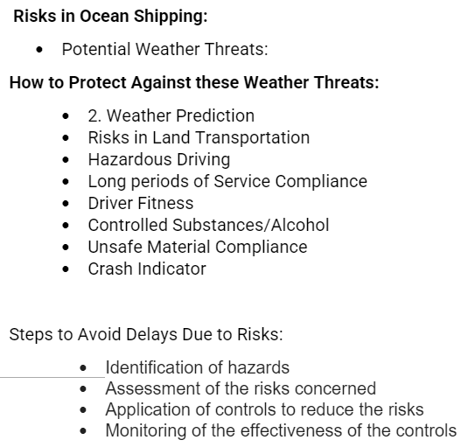
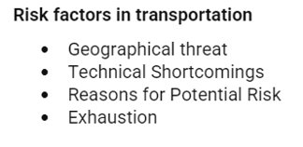
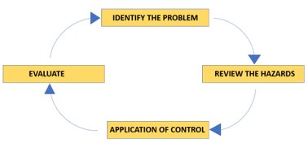
Risk Assessment

Slide 32
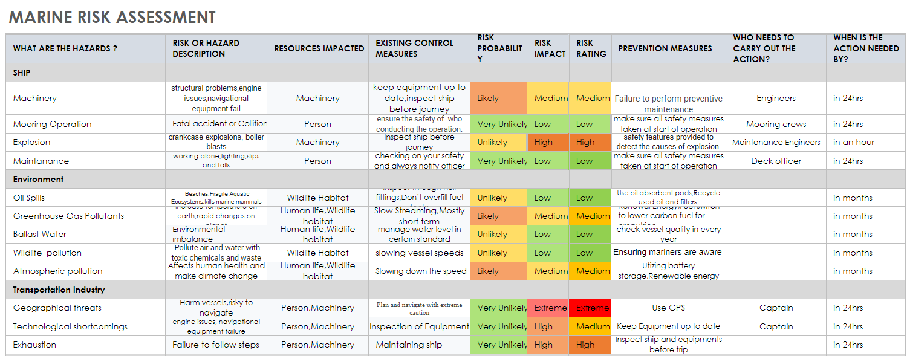
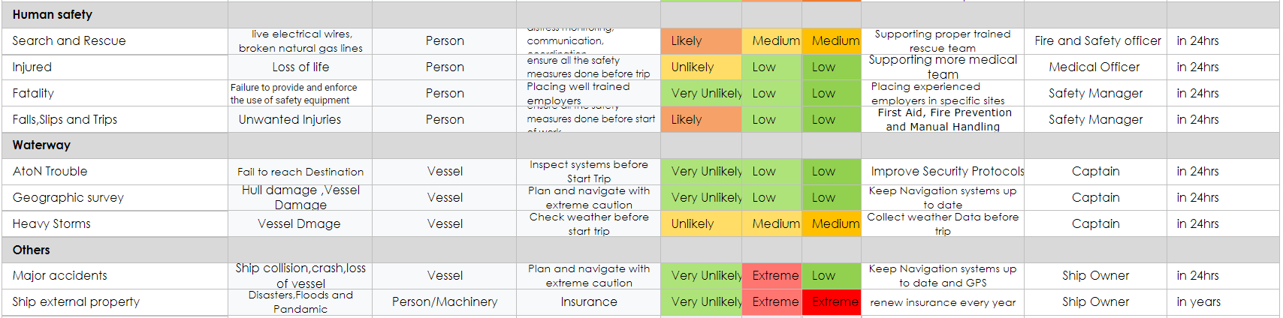
Risk Assessment

Slide 33
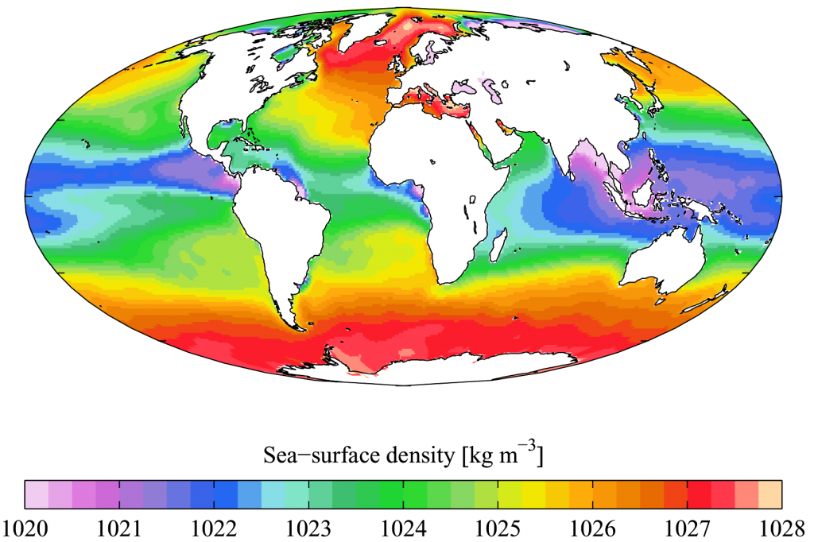

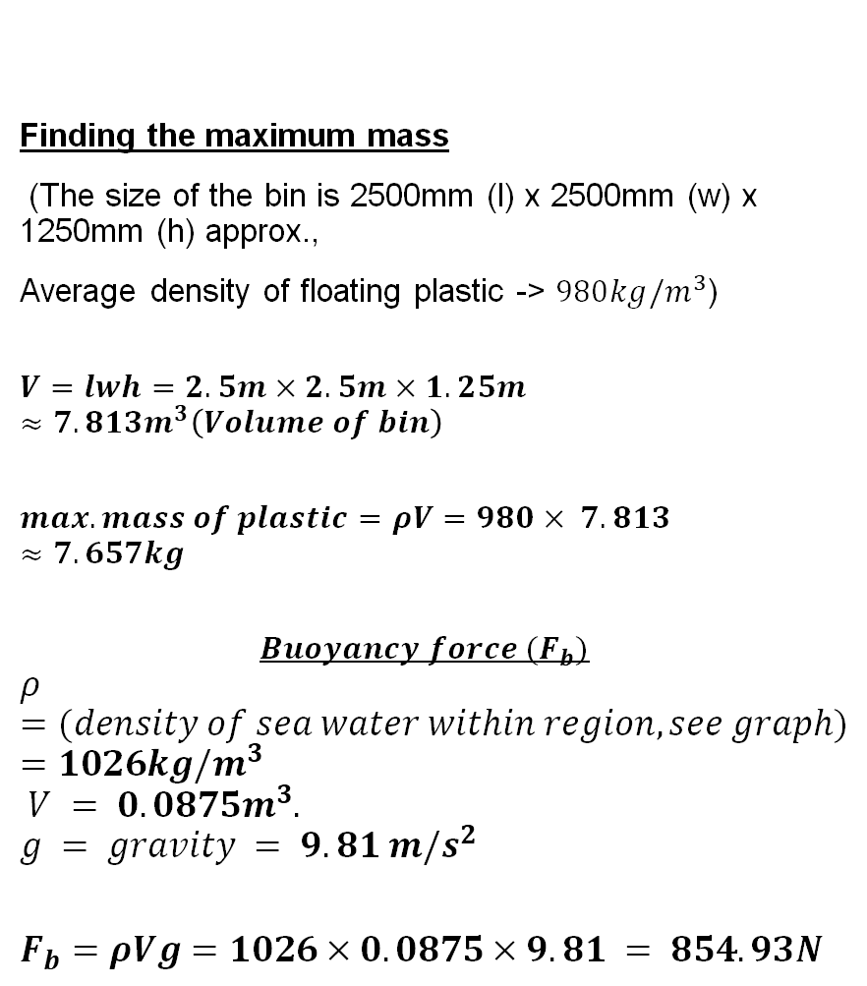
Mathematics – Crunching some numbers.
Finding the maximum mass
(The size of the bin is 2500mm (l) x 2500mm (w) x 1250mm (h) approx.,
Average density of floating plastic -> $980kg/m^{3}$)
$$V=lwh=2.5m×2.5m×1.25m≈7.813m^{3}\left(Volume of bin\right)$$
$$max. mass of plastic=ρV=980× 7.813≈7.657kg$$
$$Buoyancy force (F_{b})$$
$$ρ =(density of sea water within region, see graph) =1026kg/m^{3}$$
$$V = 0.0875m^{3}.$$
$$g = gravity = 9.81 m/s^{2}$$
$$F_{b}=ρVg=1026×0.0875×9.81 = 854.93N$$
Average density from here
Image located here
Formula from here

Slide 34

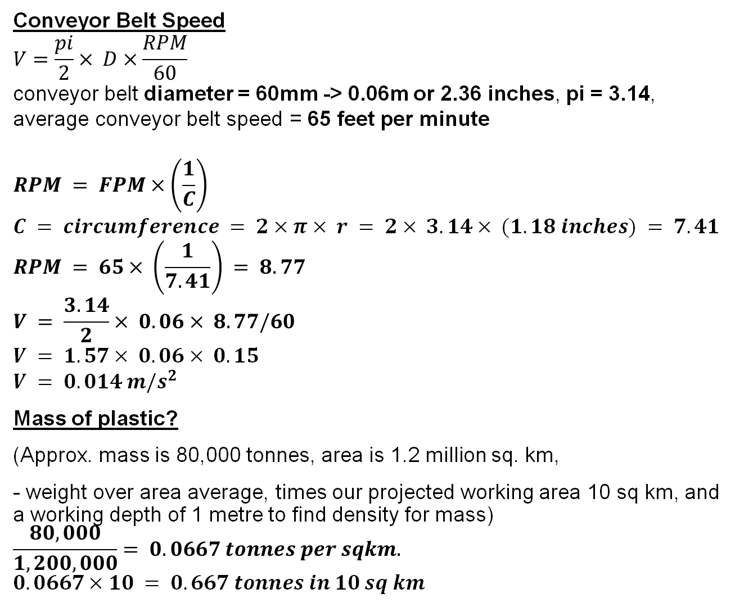
Conveyor Belt Speed
$$V=\frac{pi}{2}× D×\frac{RPM}{60}$$
conveyor belt diameter = 60mm -> 0.06m or 2.36 inches, pi = 3.14, average conveyor belt speed = 65 feet per minute
$$RPM = FPM×\left(\frac{1}{C}\right)$$
$$C = circumference = 2×π× r = 2× 3.14× (1.18 inches) = 7.41$$
$$RPM = 65× \left(\frac{1}{7.41}\right) = 8.77$$
$$V = \frac{3.14}{2}× 0.06× 8.77/60$$
$$V = 1.57× 0.06× 0.15$$
$$V = 0.014 m/s^{2}$$
Mass of plastic?
(Approx. mass is 80,000 tonnes, area is 1.2 million sq. km,
- weight over area average, times our projected working area 10 sq km, and a working depth of 1 metre to find density for mass)
$$\frac{80,000}{1,200,000}= 0.0667 tonnes per sqkm.$$
$$0.0667×10 = 0.667 tonnes in 10 sq km$$

Slide 35

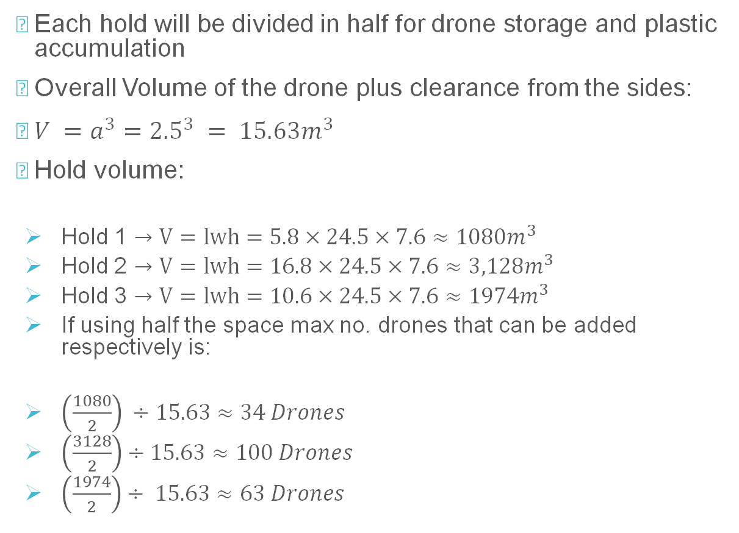
Ergonomics of the Drones
Each hold will be divided in half for drone storage and plastic accumulation
Overall Volume of the drone plus clearance from the sides:
$V =a^{3}={2.5}^{3} = 15.63m^{3}$
Hold volume:
  Hold 1 $→V=lwh=5.8×24.5×7.6≈1080m^{3}$
  Hold 2 $→V=lwh=16.8×24.5×7.6≈3,128m^{3}$
  Hold 3 $→V=lwh=10.6×24.5×7.6≈1974m^{3}$
  If using half the space max no. drones that can be added respectively is:
  $\left(\frac{1080}{2}\right) ÷15.63≈34 Drones$
  $\left(\frac{3128}{2}\right)÷15.63≈100 Drones$
  $\left(\frac{1974}{2}\right)÷ 15.63≈63 Drones$

Slide 36
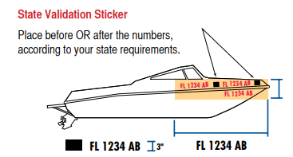

Who will Validate our System?
How and who will validate/verify this is a safe system?
USA – CFR (Council of Foreign Relations)
Ventilation (33 CFR 175/183, 46 CFR 25)
Fire Extinguishers (46 CFR 25)
Visual Distress Signals (33 CFR 175.101) - You need approved distress signals by US coast guard. Electric distress light and orange flag required.
Life Jackets (33 CFR 175)
Registration (33 CFR 173) and Documentation (46 CFR 67) - All undocumented vessels equipped with propulsion machinery must be registered in the state of principal use
https://www.uscgboating.org/images/420.PDF

Slide 37
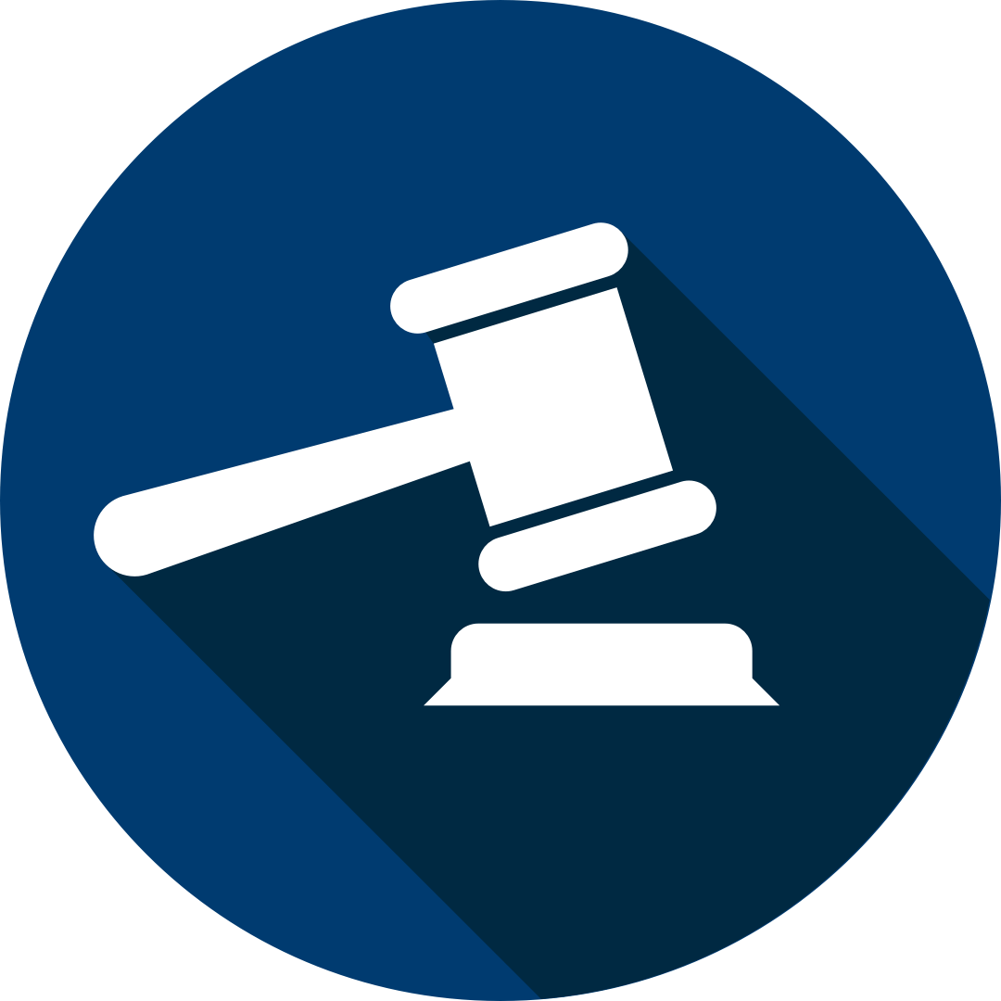
Legal Issues, Legislations and Standards
Maritime Labour Convention 2006 (MLC) - To ensure the ship provides the necessary amount of PPE (Personal Protective Equipment)
ASME – American Society of Mechanical Engineers
ASME B.30.20-3– Specifies when operator is allowed to manually position or guide the magnet during relocation
ASME B.30.20-4 – resolving compliance issues and precautions before operation
EMC – Electro-Magnetic Compliance
IEEE/ANSI C63.4 – “American National Standard for Methods of Measurement of Radio-Noise Emissions from Low-Voltage Electrical and Electronic Equipment”
Range 9kHz – 40GHz

Slide 38

Legal Issue, Legislations and Standards
IEEE/ANSI C63.10 -
Electronic Equipment
FCC part 15 - > radio frequency devices emission standard (e.g. this would apply to the drones themselves)
EMC standards -> e.g. induction motors -> EMP
MARPOL: Prevention of Pollution by Sewage from Ships ANNEX IV – circa. 27 September 2003 (link to page) – In accordance, as the part is made later on
United States Ship Registry Requirements
Prevention of Pollution by garbage from ships – circa 31 December 1988
Prevention of Air Pollution from ships – circa 19 May 2005
International Safety Management Code [ ISM ]Code for Ships
ISO 8402:1995 / BS 4778 define risk management, which includes maritime risk assessment as: “The process whereby decisions are made to accept a known or assessed risk and/or the implementation of actions to reduce the consequences or probability of occurrence

Slide 39

Steps Going Forward; What's left to do?
On Shore Offloading Method (From cargo to transport, from transport to post collection solution)
Rapid Prototyping of Drone design to develop it to a working prototype
Testing of electrical systems and Actual power requirements.
Comparison of Canadian and USA shipping regulations to identify most cost effective and Complient mooring port.
Costing and expenditure evaluation.
Development of S.O.P (Standard Operating Procedures)
Power requirements of propulsion method need to move fully Laiden Drone.
Power storage methods and recovery methods on power out.

Slide 40

References 1
Academy of EMC, Education for professional engineers. Available from: https://www.academyofemc.com/emc-standards
Alibaba.com, Magnet Lifter. Available from:https://www.alibaba.com/product-detail/Permanent-magnetic-lifter-Steel-Scrap-Circular_62362833817.html
Appolo Duck, Commercial Vessels Cargo Ships. Available from: https://commercial.apolloduck.com/boat/commercial-vessels-cargo-ship-for-sale/692196
Clear Blue Sea, (2022), Meeting FRED. Available from: https://www.clearbluesea.org/meet-fred/
Crane1. Lifting Magnets Safely. Available from: link here for ASME Regulations
Energy Observer, (2016). Available from: 2017 Energy Observer
Handybulk LLC, Available from: https://www.handybulk.com/united-states-ship-registry-requirements/
Marine Engineering, (2018). Available from: https://www.meoexamz.co.in/2018/11/load-line-why-it-is-important.html
Marine in Sight, April(2022). Available from:https://www.marineinsight.com/maritime-law/marpol-convention-shipping/
Ostle, C., Thompson, R.C., Broughton, D. et al. The rise in ocean plastics evidenced from a 60-year time series. (2019). Available from: https://www.nature.com/articles/s41467-019-09506-1
The Great Bubble Barrier, (2016). Available from:https://thegreatbubblebarrier.com/
UCLA Sustainability, Available from: https://www.sustain.ucla.edu/what-is-sustainability/632324625

Slide 41
References 2
Science Direct, Elsevier, Plastic Pollution Solutions (2020). Available from: https://reader.elsevier.com/reader/sd/pii/S0160412020320225?token=F6CAAE0F89A423F740A445937AF982A11D587385CFFAA7890773BF454B88B4EDECDDE281322F82F2725E5277BB495B76&originRegion=eu-west-1&o
Sun, F., Qin, J., Wang, Z. et al. Energy-saving hydrogen production by chlorine-free hybrid seawater splitting coupling hydrazine degradation. Available from: link to obtaining hydrogen from seawater overview
Teachable Machine. Available from: https://teachablemachine.withgoogle.com/train
Fourth meeting (Part II) of the Special Tripartite Committee (STC) of the Maritime Labour Convention, Available from: wcms_844193.pdf (ilo.org)
The Ocean Cleanup, Available from: https://theoceancleanup.com/oceans/ and https://theoceancleanup.com/great-pacific-garbage-patch/
University of Bath, Risk Assessment Guidance. Available from: https://www.thesubath.com/pageassets/health-and-safety/Rick-Assessment-Guidance-Notes.pdf
Woods Hole Oceanographic Institution. Available from: https://www.whoi.edu/know-your-ocean/ocean-topics/ocean-life/ocean-plants/phytoplankton/#:~:text=The%20thickness%20of%20this%20layer,very%20different%20kinds%20of%20organisms.

Slide 42
References 3
Solar Power Authority. Available from: https://www.solarpowerauthority.com/depth-look-different-types-solar-panels/
Solar 3.0 Perovskite Cells. Available from: https://www.youtube.com/watch?v=tQmFVcD-Mbo&ab_channel=ElectricFuture
Average density of Seawater: Available from: https://hypertextbook.com/facts/2002/EdwardLaValley.shtml
Thin film PV solar Cells. Available from: https://www.archetech.org.uk/flexible-thin-film-solar-photovoltaic-cells/
World Sailing Code of Ethics, May (2019). Available from:https://www.sailing.org/tools/documents/2019CodeofEthicsPostMidYear-[25097].pdf
Youtube, The Ocean Cleanup. Available from: https://www.youtube.com/channel/UCYXGHivsMPVU-
Research Square, Proposing a New Route to Solve Marine Debris Pollution Issues. Available from:https://assets.researchsquare.com/files/rs-905766/v1/5637664d-defa-4468-8f57-7cad06fb6021.pdf?c=1

Slide 43

Thank you for Listening!
Are there any Questions?

