Slide 1
Why can’t an Occupational Therapist do that? My journey into research
Occupational Therapists working in Diverse Settings Conference
18th November 2022

Slide 2
Today’s aims
Share my journey as an Occupational Therapist (OT)
Explain the current project and give a case study
Describe my current role and skills used
Look at why you could consider a career in research
Advocate for OTs in non-traditional roles

Slide 3
My Background
Qualified from Queen Margaret University in Edinburgh in 2012
Moved home to Oxford
Variety of roles – acute medical rotation, community therapy rehabilitation, social prescribing, stroke research and continuing healthcare
Developed chronic illness and had to consider ‘occupational balance’ afresh
Now manage a team within a combined clinical and research memory service

Slide 4
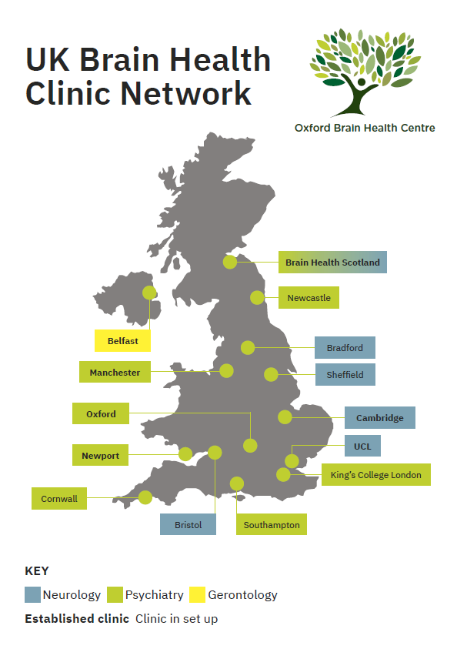
Brain Health Centres in the UK

Slide 5
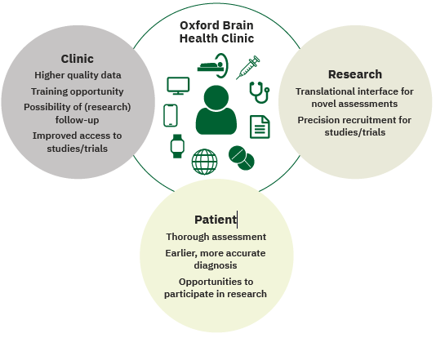
Oxford Brain Health Centre

Slide 6
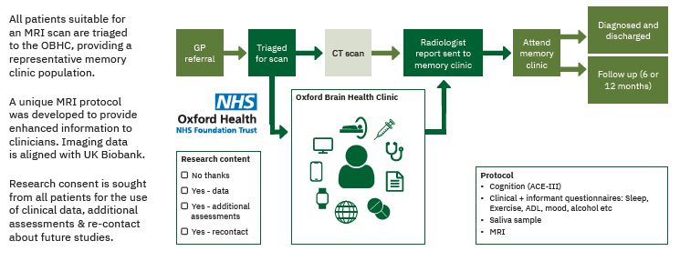
Clinic Day Pathway

Slide 7
Typical day?
There isn’t one!
Clinic day involves three patients visiting Attend for 2+ hours
Always attend with a family member/carer – able to share observations
Patient has an MRI scan and completes standardised memory assessments
Escalation example

Slide 8
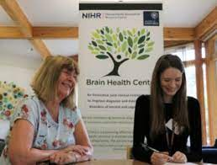
Current Occupational Therapist skills and qualities I’m using
Communication
Networking across the Trust
Leadership
Person-centred care
Facilitating training
Expert practitioner work
Risk assessment
Maintaining records
Problem solving
Creativity

Slide 9
Skills I am gaining
Project management
People management
Leadership
Patient and Public Involvement work
Service development
Understanding the life cycle of a research project
Developing an awareness of research methodologies
Monitoring compliance
Gaining further knowledge and theory in a specialist area
Theory to practice

Slide 10
Why research?
What attracted me to research?
Chance to combine clinical knowledge with a more flexible role
Able to contribute to the evidence base
Consumer not producer!
Cutting edge
Proactive as opposed to reactive
Links with Royal College of Occupational Therapists (RCOT) priorities
4 pillars of practice
RCOT 10 key priorities

Slide 11
Why can’t an Occupational Therapist do that?
My job was advertised originally as a nursing post
I read the job description and decided to enquire if an Occupational Therapist could do the role

Slide 12
Top tips for exploring research opportunities
Don’t be put off by job adverts – look for alternative job title wording
Ask! Put Occupational Therapy forwards
Find out what’s going on in your service or area
Link in with local NHS Trust(s)
Look at roles within the third sector services e.g. Cancer Research UK, Alzheimer’s Society
Look at roles within Educational Institutions

Slide 13
Resources
RCOT Research and Development page: Research and Development - RCOT
RCOT top 10 priorities for research: Top 10 priorities for occupational therapy research in the UK - RCOT
RCOT Career Development Framework - Career Development Framework - RCOT
RCOT podcast on ‘why do research priorities matter’: Our Podcast Collection - Listen or Download Today! – RCOT
RCOT regional committees - Regions and Local Groups - RCOT
NIHR Signals Occupational Therapy Research Summaries – RCOT
National Institute for Health Research National Institute for Health and Care Research | NIHR
Council for Allied Health Professions Research - Council for Allied Health Professions Research (csp.org.uk)
Applied Research Collaborations (ARC) - Welcome — NIHR Applied Research Collaboration Oxford and Thames Valley
Dame Barbara Windsor Dementia Mission - Prime Minister launches 'Dame Barbara Windsor Dementia Mission' - GOV.UK (www.gov.uk)
Dementia UK Strategy – Dementia-UK-2020-2025-strategy.pdf (dementiauk.org)

Slide 14
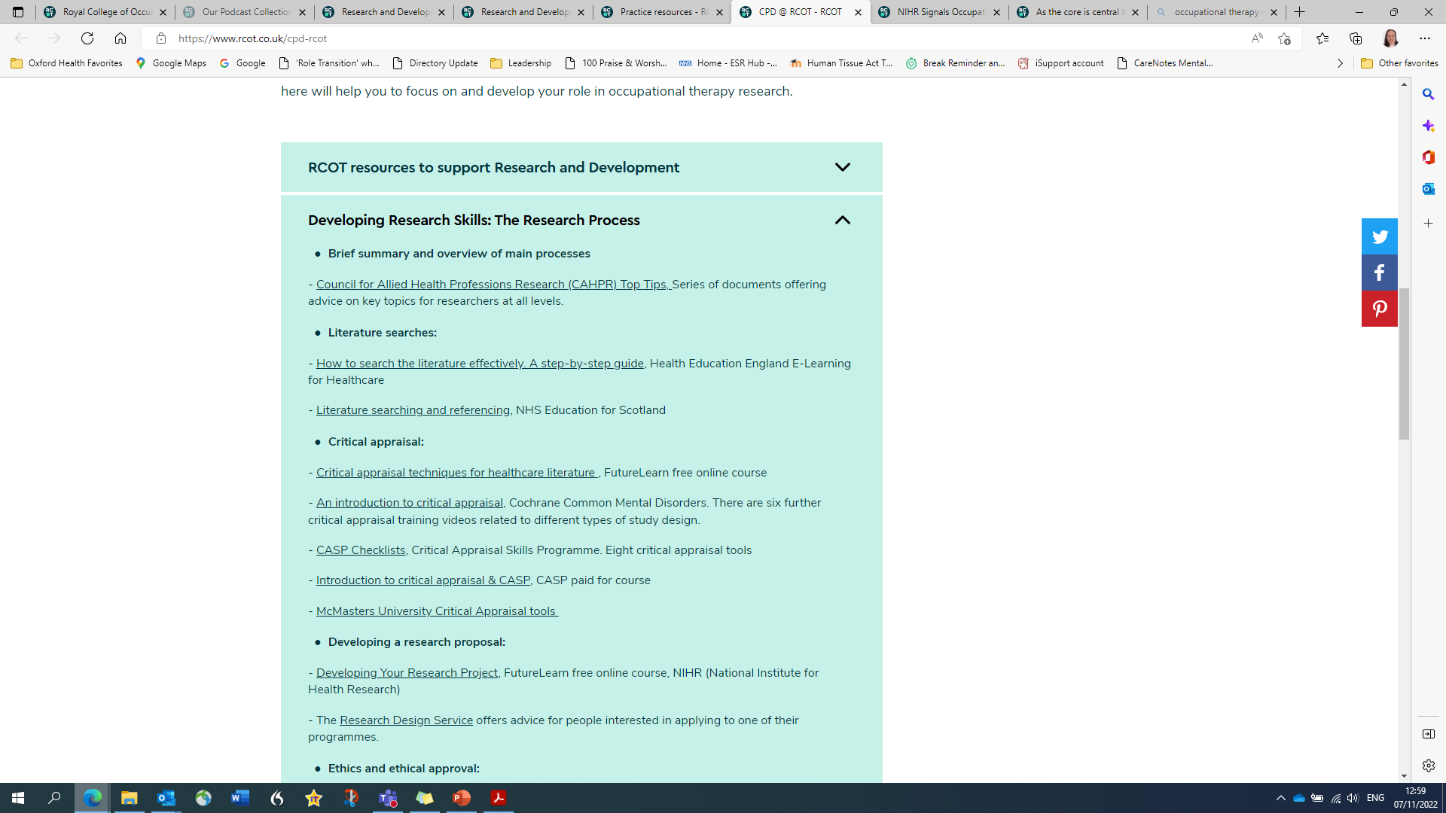

Slide 15
Thank you for listening!
Contact details: Robyn.Harris@oxfordhealth.nhs.uk
Oxford Brain Health Centre: Welcome to the Oxford Brain Health Clinic – NIHR Oxford Health Biomedical Research Centre
Any questions?

