Slide 1
Callum MacKinnon
Founder & Occupational Therapy Lead
@bounceot
@CallumMackOT

Slide 2
Outline
About me…
About bOunceT
About rebound therapy & therapeutic play…
Keep in touch!
Social Enterprise – The future of OT

Slide 3
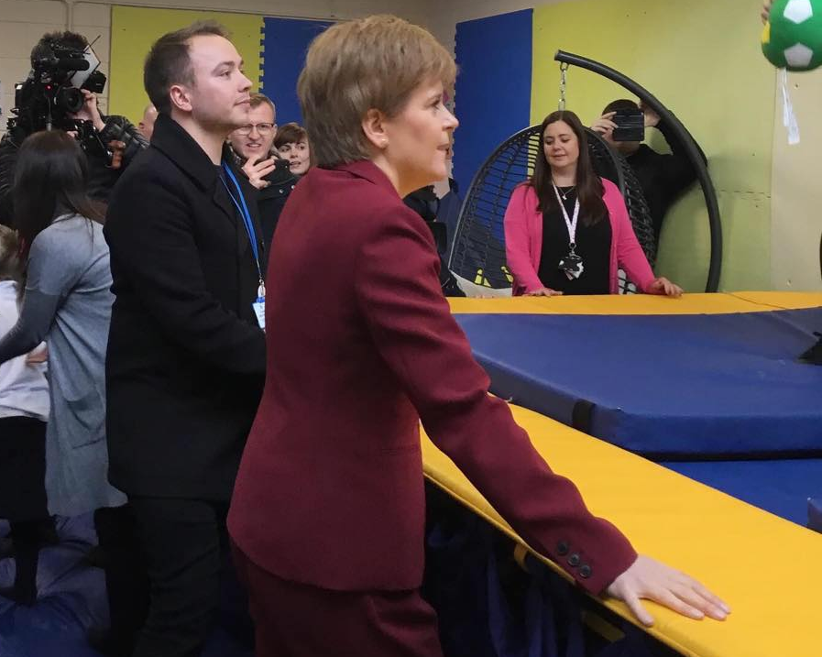
About me…
International Business - GCU.
Camp America (Upstate NY, 2012-15)
Occupational Therapist
Sensory Integration Practitioner
MSc (Post-Reg) OT Student at QMU.
Lead Therapist in NIHR clinical trial group – Managing Repetitive Behaviours (MRB) NHS Lothian & University of Edinburgh.
Vice Chair – RCOT SSPLD.
Social Entrepreneur.
Notes:
Summarise this slide – just to give an overview about me and my roles.
-When I do presentations like this I am usually trying to ‘convince’ people why I am in independent practice so young. Within the business world, this is something that is praised and has been noted as being better (hence winning awards) but often not praised within OT world.

Slide 4
“I wanted to set up the social enterprise initially as I just wanted to see something different in my local area, that I knew would benefit the health and well-being of the population that I was already working with as a support worker. I already had a lot of experience working with people with disabilities, and their families, so I felt as though I had a good idea about the key challenges they faced. I knew there should be more services available to them that addressed these needs specifically – I knew that I could help”

Slide 5
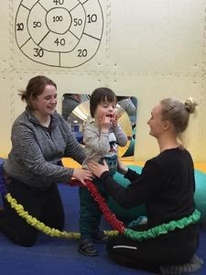

Slide 6
About Bounce ot..
Vision:
For all individuals to be happy, healthy and be able to participate in whatever activities they want to, need to, or have to do.
Mission:
To improve the quality of life and participation in meaningful occupations for children and adults with disabilities, and their family, in Scotland.
Values: PLAY
“play as a means to achieving other developmental goals.”
“play as an occupation: play as an aim, play as a right, and play for participation”
(Lynch & Moore, 2016)

Slide 7
About ‘rebound therapy’
Defining ‘rebound therapy’ & where it fits within Occupational Therapy – bOunceT
Must read blog ^^^
“As there is no regulatory body for this intervention, there is no one-single organisation who can deliver training in rebound therapy and there is no membership or license to accredit you to do this” Advertising Standards Authority, 2016
safe_practice_in_rebound_therapy_01_10_16_0.pdf (csp.org.uk)

Slide 8
Health promotion

Slide 9
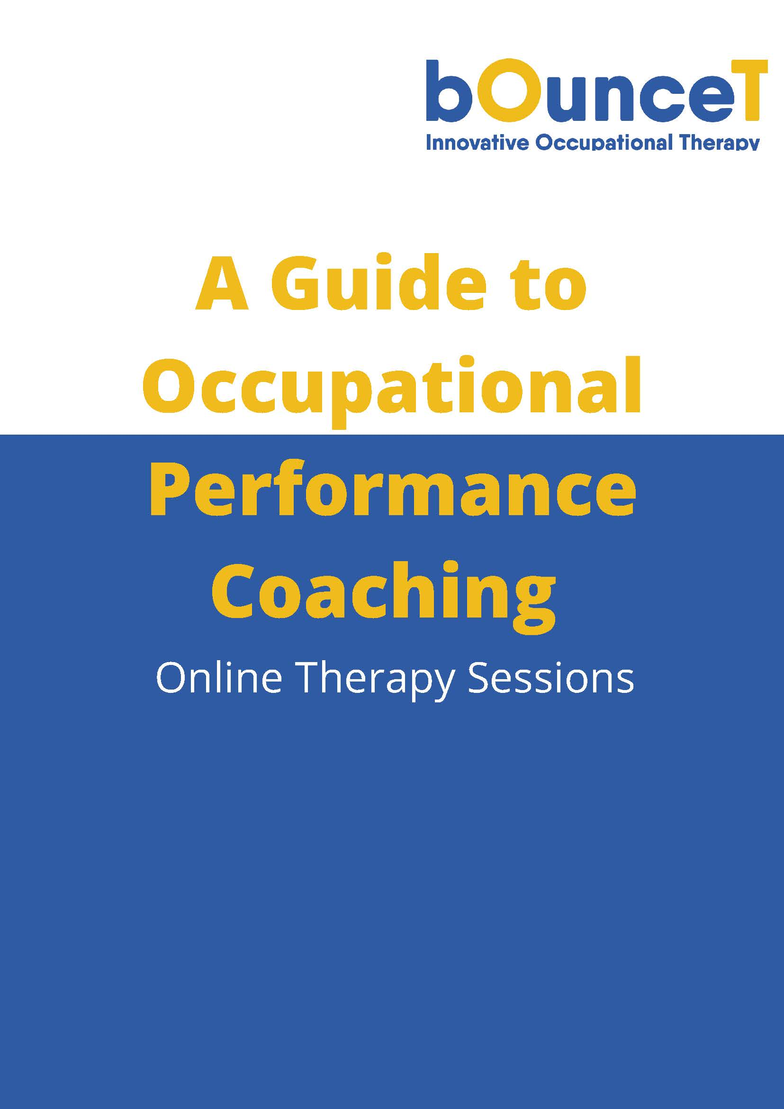

Slide 10
Social Enterprise
£300,000+ grant funding awarded since 2017.
Turnover: Sales generated from Self Directed Support (SDS) payments, memberships & other public or private contracts.
Currently applying for a tender – framework agreement with Stirling Council
Awards: Social Enterprise Runner Up (2017) Social Enterprise Champion Under 26 (2018) Entrepreneur for Good Scotland Finalist (2019)
Funders don’t always ‘care’ about the same outcomes we do as therapists…& we are already ‘doing good’ in our area of work – so why not get some ‘free cash’ to meet a local need?
BLOG Social Enterprise – the future of Occupational Therapy (Callum’s MSc journey) – bOunceT

Slide 11
COVID-19 Response

Slide 12
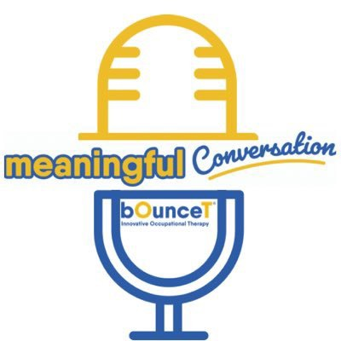
@bounceotpodcast
@meaningfulmoments

Slide 13
Keep in touch…
@CallumMackOT
@bounceot
www.bouncet.com
callum@bouncet.com

