Slide 1
Being a change agent: Actively disrupting injustice 5th annual conference for occupational therapy in diverse settings
Become what you want to be
‘Mish’ Musharrat J. Ahmed-landeryou
London south bank university
Twitter: @Lecturermish
Email: ahmedlmj@lsbu.ac.uk
Notes:
Thank you and welcome everybody. How are you? I hope you are well. Maybe share your answer to that question on the chat channel, and again connect with each other, as I start my keynote.
Being a change agent, is a timely topic in a conference, especially knowing what is being raised by society,
not only nationally but globally.
For example, the climate emergency, health equity and institutional racism and discrimination in the health and social care and charity sectors.
These are not unconnected, as this is about humanity, about the survival of the human race and the planet.
Being a change agent is disrupting injustice.

Slide 2
Change is happening all around us

Slide 3
Change Agency
“the power, individually and collectively, to make a positive difference. It is about pushing the boundaries of what is possible, mobilising others and making change happen more quickly”
(School4ChangeAgents Horizons NHS 2018)
Quote from: https://nhshorizons.passle.net/post/102er8k/change-agency-the-power-to-make-a-positive-difference-some-reflections-follo

Slide 4
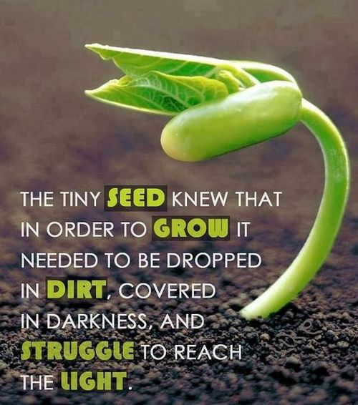
Seed of change
Quote by Sandra Kring, author

Slide 5
What matters to you matters to me, matters to change making

Slide 6
books

Slide 7
Pause

Slide 8
Purpose

Slide 9
praxis

Slide 10
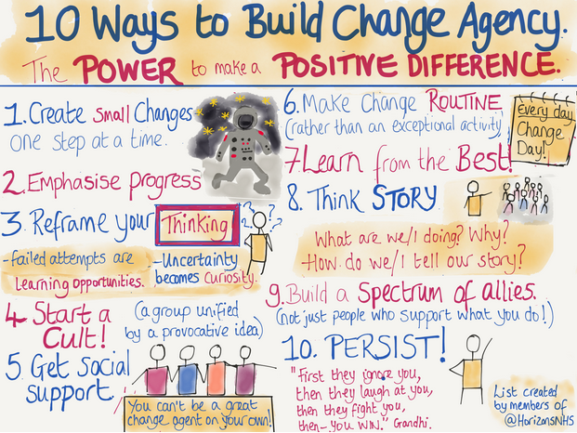
https://nhshorizons.passle.net/post/102er8k/change-agency-the-power-to-make-a-positive-difference-some-reflections-follo

Slide 11
Pause-purpose-Praxis venn diagram
Change Agent
Praxis
Purpose/s
Pause

Slide 12
It’s ok to… venn diagram
Change Agent
Be political
Collabo-rate
Fail, but learn & progress

Slide 13
LIBERATION

Slide 14
Pledge of realistic change making action
What’s yours?
Share it in the chat channel

Slide 15
References
Brian H., Cook S., Taylor D. (2015). ‘Occupational therapists as change agents in multidisciplinary teams’. British Journal of Occupational Therapy, 78(9), pp. 547–555. doi: 10.1177/0308022615586785
Cameron E., Green M. (2020). Making sense of change management: A complete guide to tools and techniques of organisational change (5e). London, UK: Kogan Page
Carrier, A., & Beaudoin, M. (2020). Conceptualizing Occupational Therapists’ Change Agent Role To Support Entry-Level Pedagogical Activities: Results From A Scoping Study. Journal of Occupational Therapy Education, 4 (3), pp. 1-23. https://doi.org/10.26681/jote.2020.040303
Kotter J.P. (2012). Leading change. Harvard, USA: Harvard Business Review Press
Laloux, F. (2014). Reinventing Organizations: A Guide to Creating Organizations Inspired by the Next Stage of Human Consciousness. Brussels: Nelson Parker
Senge P., Scharmer C.O., Jaworski J., Flowers B.S. (2008). Presence: An exploration of profound change in people. New York, USA: Crown Business
Zokaei A., Seddon J., O'Donovan B. (Eds.).(2011). Systems Thinking: From Heresy to Practice. Public and Private Sector Studies. London, UK: Palgrave MacMillan

Slide 16
Any questions
Become what you want to be

