Slide 1
Accessibility
And why it matters
to everyone.

Slide 2
Introduction
What this is
What this is not
A guide to accessibility using the CMS
Guide to the using the CMS
A general accessibility guide

Slide 3
What we will cover
CMS specific
General
Alt text and imagery
Link text and link titles
Use of headers
Tables
CAPITALS
New videos need captions
Accessible documents
Siteimprove
Resources

Slide 4
Overview
At least 1 in 5 people in the UK have a long term illness, impairment or disability
Many more have temporary disabilities
Public Sector Bodies (Websites and Mobile Applications) (No. 2) Accessibility Regulations 2018… AKA the EU Website Accessibility Directive.
Websites must become ‘perceivable, operable, understandable and robust’ as of 23 September 2019.
Notes:
We do it to help people read our website properly.
We do it because it is the right thing to do.
We do it because it is the law and the fines can be hefty.
A temporary disability could be an eye injury.

Slide 5
This demands that the university…
Make the website content accessible to everyone
Provide a public accessibility statement
Provide a feedback mechanism for users to report inaccessible content
Provide a link to the enforcement procedure
You only need to worry about the first point, that’s all, just that.

Slide 6
Screen readers and accessibility devices
What are screen readers?
Why do people use them
Other devices also exist
Someone with motor difficulties might use a special mouse, speech recognition software or on-screen keyboard emulator.
Keyboard compatibility
Notes:
Show videos
https://youtu.be/dEbl5jvLKGQ up to 1.50
https://youtu.be/93UgG72os8M

Slide 7
Alt text and the use of imagery to convey information
What is alt text?
Why do we need it?
Context, what is the image showing?
Decorative
Supportive
Contains information that can only be displayed as an image
Caption your image if needed
Notes:
Decorative is just that, the image can be removed and the page content will not change.
Supportive is when the image can be removed but its presence helps the page with added information
Contains information means that you have to write detailed captions for the image.
Do not use an image to replace text, use it (with appropriate alt text and captions) to supplement it.

Slide 8
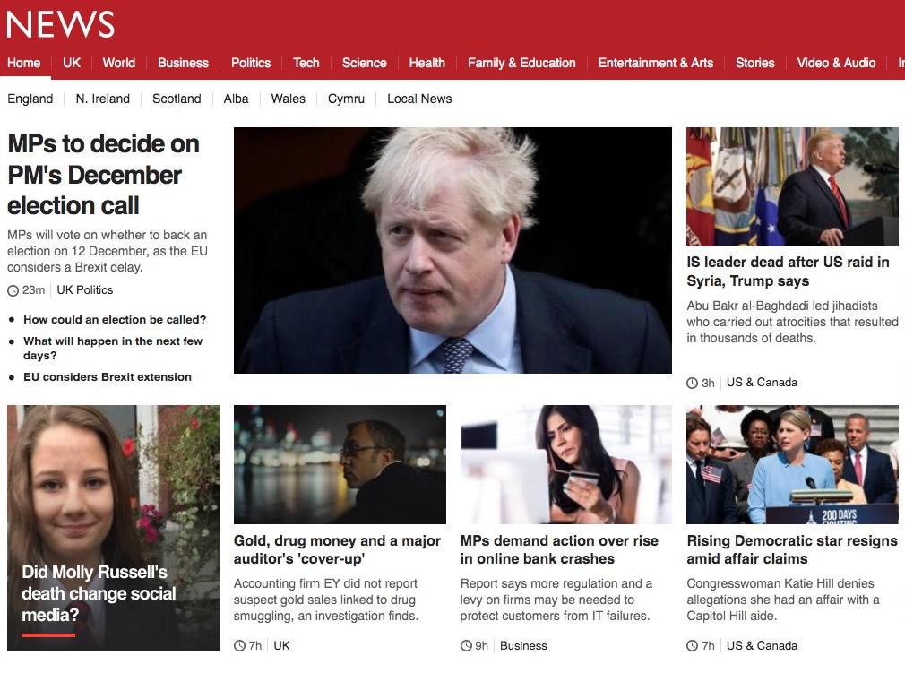
With images…

Slide 9
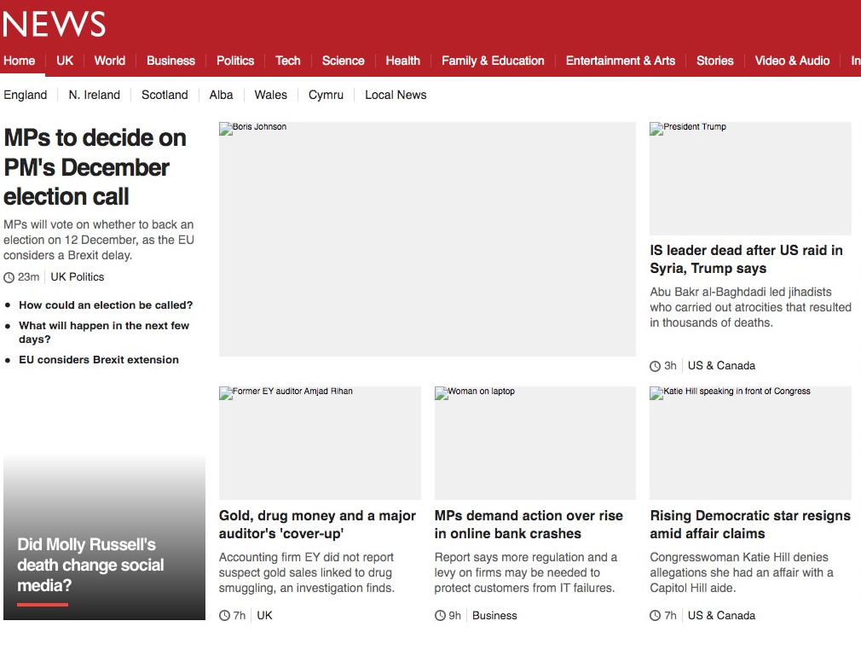
Without images

Slide 10
What is the alt text here?
For an open day
For student ambassador recruitment
General university course page
Notes:
Alt text can be the same or different for the same image on different pages, can be adapted to suit the content.
Show video
https://youtu.be/dEbl5jvLKGQ (continue to 2:20)
CMS exercises
Putting in an image onto a webpage and using alt-text
Putting an existing variation and checking alt-text
Checking alt-text
Renaming files before they go into the CMS and why

Slide 11
Link text and link titles
What is link text?
What is a link title?
What can we do to make it better?
Notes:
Link text is the sentence that the link goes from.
Link title is the hover over, it is not supposed to be the same as the link text, but should be additional information.
Link title is completely optional is you do not have anything further to say about the subject.

Slide 12
Link text should be…
Descriptive – Never use click here.
Do not use the same link text on a page with different destinations
Do not use same destination with multiple links on a page
Do not use too many links on a page if possible
Do not make the link text too short
Notes:
The same link or the same link text makes this confusing for screen readers.
The screen reader will say “Link click here” and “Link click here” and “Link click here” which is not helpful.
Short link text makes it difficult for those using other means to find a link (such as eye tracking)
CMS exercise
Create a link
Create another to the same destination
Use titling

Slide 13
Headers and the proper use of structure
Why do we use headers?
Headers come in different sizes (H1, H2, H3 etc)
These should be used sequentially and not skipped
Bold is not a header!
Bold has no impact on a page save to distract the eye
The CMS has styling options to reduce the amount of space
Notes:
Headers are not just for breaking up content but also for structuring it. In addition, they allow screen readers to identity sections and if properly coded allow readers to skip to the next section.
Headers start from H1 to H6 (or possibly smaller) and should always be used in order. Do not skip headers.
Bold is useless as a header. The eye is drawn to bold words potentially missing important content.
CMS exercise
Find headers in style and format menus
Make proper headers
Convert bold text into header

Slide 14
Tables
Do you need a table?
If yes…
Captions and why we use them
Row and column headers – do not use bold
Do not merge or split cells
Consider making complex tables multiple tables, if possible
Notes:
Captions are for screen readers so that the reader knows a table is present and what basic information will be found in it.
Row and column headers help readers understand a tables contents and give an idea of what will come next. Bold is not a header.
Merging and splitting cells can be confuse both screen readers and their users.
Show video
https://youtu.be/dEbl5jvLKGQ (continue to 4:00)
CMS exercises
Create a table
Use rows, columns
Convert cells into headings

Slide 15
CAPITALS
Why do you use them? Just, why?
Capitals are SHOUTING. WHY DO YOU NEED TO SHOUT?
Capitals are difficult to read for people without disabilities
Dyslexics find them more difficult
At least 10% of readers have some kind of dyslexia
Screen readers can read them letter by letter
Never use them except as punctuation
There is some CMS styling, but you write it normally
NEVER use them.
Notes:
Capitals are basically large rectangles and can be difficult to differentiate.
Studies show that even people without disabilities read them slower.
CMS styling is not read by a screen reader, it reads who the editor has written the text, so type normally. If styling is to be used, let the styling do the work.
We have reduced the amount of capitals on the webpages, only primary CTAs and the Key facts box use them.
Names with capitals such as “SHOUT Cleaning products”. What to do? Apply styling where possible (not possible yet within the CMS) or
CMS exercise
Create a Primary CTA and style it

Slide 16
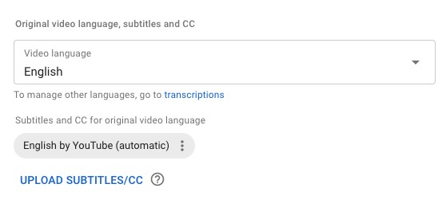
New videos need captions
All videos added to a public website need to be captioned
You cannot do this in the CMS but YouTube has some tools
Notes:
YouTube has options for automatic captioning or for you to upload your own. It even allows for viewers to upload their own to your videos, but be wary of this!

Slide 17
Accessible documents
From September 2019, all new documents must be accessible
If you are putting links to documents, it is your responsibility to ensure that a document is accessible
This includes linking to documents on Staff Central
If in doubt, don’t
Microsoft Office and Adobe Acrobat can check certain documents
Notes:
This includes all documents you create, link to or are asked to link to.
If these are not your documents, email the creator or the person who asked you to put them up. If they are not sure, they are probably not accessible and thus you cannot put them up until they are.
The CMS cannot check documents, but Microsoft Office can check documents and so can Adobe.
Show accessibility on this document
On the Mac (Office 2019) Tools menu/Check accessibility
On the PC (Office 2018) File menu / Check for issues / accessibility

Slide 18
Siteimprove
There are some tools that can help
Siteimprove is one we use
Has a section on accessibility
Gives a benchmarked score
Highlights issues
You can create policies
You can create reports for selected readers
Notes:
Siteimprove is good for many things, such as quality assurance (links, spelling) as well as accessibility to industry standards.
Siteimprove
Show dashboard and university score
Show accessibility section for various roles (webmaster, editor, developer)
Show policies page and what policies can do (find content for change)
Show reports Main menu/settings/reports (we do not use accessibility reports at present); click on New schedule for details on when it runs and who it sends it to.

Slide 19
Resources
University documents https://staff.brighton.ac.uk/clt/inclusive/Pages/Creating-accessible-documents.aspx
Government documents https://www.gov.uk/guidance/accessibility-requirements-for-public-sector-websites-and-apps
Other https://www.w3.org/WAI/tutorials

