Slide 1
Academic planning & writing
The outline process

Slide 2
What is an essay
a piece of writing that has a particular structure (e.g. starts with an introduction) and a logical sequence
Godfrey (2009) refers ‘The Diamond’ structure
written in a formalised academic style not in a conversational manner e.g. don’t (more on this later)
usually you will be given the title sometimes referred to as ‘the question’ and it will have a word limit
analogous to a criminal court case

Slide 3
Why do we write essays
it is part of the assessment task on the module you are taking
enables you to demonstrate that you have met the learning outcomes for the module
learning and writing is an iterative process that allows a dialogue between you and the tutor.
feedback on your writing is part of the learning process
allows you to develop your writing skills
you can express your own views about the topic and makes links between the theory and your practice
engage in critical debates in your subject area (aside Twitter)

Slide 4
Differences between writing at Level 4 and level 5/6
Level 4
Knowledge and comprehension
Level 5
Knowledge, application and analysis
Level 6
Application, analysis, synthesis and evaluation

Slide 5
Knowledge and comprehension
About remembering and explaining information
Relevant words
Knowledge: define, identify, present, relate
Comprehension: interpret, distinguish, explain, summarise

Slide 6
Application, analysis, synthesis and evaluation
This is about
Using information in different ways
Applying knowledge and comprehension to a problem or situation
Dividing something into its constitute parts and examine the relationship between those parts
Compiling information into different solutions or putting information together in new way
Making reasoned judgments
Relevant words
application/applying: produce, relate, select, chose, illustrate
Analysis: distinguish between, differentiate, compare, contrast
Synthesis: plan, prepare, formulate, construct
Evaluation: judge, assess, critique

Slide 7
Module learning outcomes
1. Identify research methods to investigate and elicit factors that produce health and promote the health and wellbeing of individuals ,groups, communities and populations.
2. Evaluate epidemiological and research methods to draw causal inferences
3. Discuss how epidemiological and research evidence may be used to map and reduce health inequalities.
4. Analyse the contribution epidemiology and research may make to the development of policy, services, practice and treatments
5. Critique epidemiological and research findings

Slide 8
The writing process
Cottrell (2013) suggests a seven point plan
clarify the task
organise and plan
collect and record information
reflect and evaluate
write an outline plan and first draft
work on your first draft
final draft

Slide 9
Clarify the task
ensure you know what you are being asked to do
may help to write it out in your own words
check with your lecturer if you are not sure
Consider the following
‘Choose an aspect of continence care and analyse the evidence base which currently underpins your practice in this area’
‘Bladder training is widely used in the treatment of urge urinary incontinence. Critically analyse the evidence base which currently underpins practice in this area’
what do you already know about the topic
identify areas that are unclear

Slide 10
Clarify the task
Consider this example from a level 4 module
An individual 20 minute poster presentation to a small group of students. One examiner and one moderator, of a situation from practice relating to communication. The poster presentation should demonstrate the importance of and barriers to effective communication whilst recognising the needs of the individual. Strategies for effective communication should be discussed. Appropriate literature will be used as references to support the content of the presentation, and a copy of the reference list will be submitted in turnitin.

Slide 11
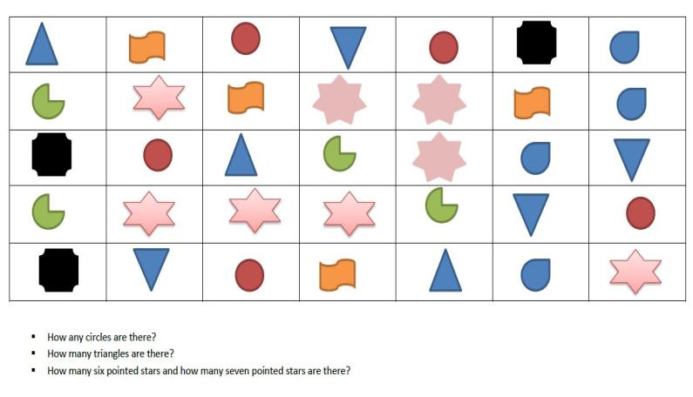
Organise and plan

Slide 12
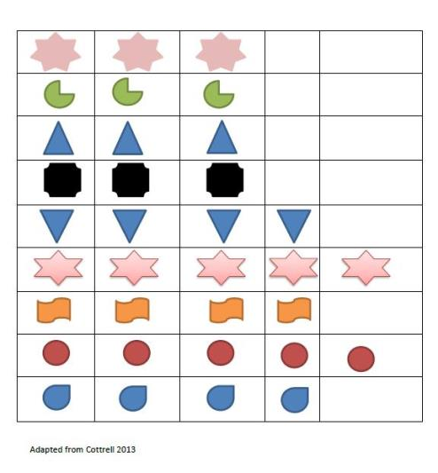
Organise and plan

Slide 13
Organise and plan
Organise
use a chart or mind map to link ideas and details this will help with the research stage
or use ‘post-it notes’ to identify areas in the subject you want to address eventually these will map to paragraphs in your essay make a rough essay outline plan as this will help your shape your ideas and provide a focus for your reading
Make sure that you back up your work
Plan
review what you are doing to prevent repetition (common mistake)
subject areas in your introduction map to sections in the body of the essay
Manage your time identify time to write but be realistic. little and often
Find a space to study

Slide 14
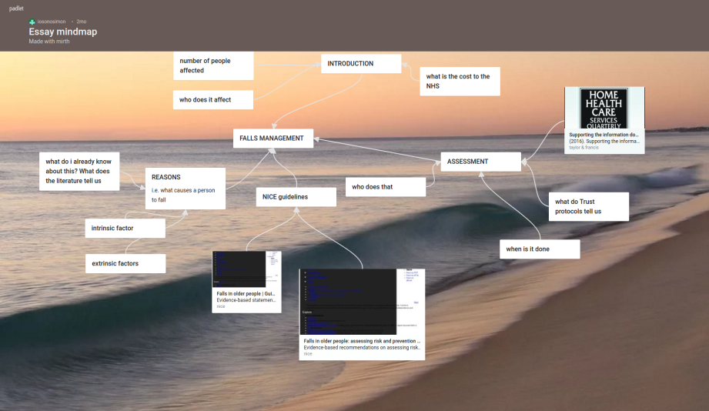
Organise and plan

Slide 15
Collect and record information
Research is the building block of any writing
use a wide range of resources
journals, books, NICE guidelines, Trust policies/protocols
10 year rule
Think about your sources of information
be selective you can’t use everything
12-15 references is about right for a 2500 word essay
keep a notebook to hand to jot down ideas
when you’ve read something make a note of where you have found it. use apps like Pocket to save content

Slide 16
Collect and record information
framing what you are writing about as a question will help you identify key words and phrases to aid your search for literature
You might use a framework like SPICE to help you produce a defined question
Setting e.g. community
Perspective e.g. community nursing team
Intervention
Comparison
Evaluation what conclusions can be drawn
Does hand washing prevent cross infection?

Slide 17
Reflect and evaluate
when you’ve gathered enough information step back to review where you’ve got to
ask the following questions
what have you discovered
has your view changed
have you clarified your argument
do you have enough evidence or too much
does the literature show opposing arguments

Slide 18
Write an outline plan and first draft
refine your plan from step three. in what order are you going to introduce each point
use a numbered list/bullet points or headings to help
get some sense of how many words you want to write for reach point (300 words is approximately one side )
write out the first draft which does not have to be in order (especially if you have got writers block)
do not worry about the style at this stage
when you cite a source make a note of the fuller reference at the bottom of your document

Slide 19
Work on your first draft
this is the stage where you develop what you have first written
Cottrell (2013) suggests you save your drafts as separate files e.g. draft1, draft2 and so on. Alternatively use the comments and tracking function in MS Word
check that your information is grouped and ordered into paragraphs
check that your argument is clear from one paragraph to the next. add sentences if necessary to link ideas (remember linking words)
check you have evidence to support want you have said (if you say “research shows’ cite the source)
if necessary look places where you can summarise what you have written to make the most effective use of the word count
put together the reference list using the correct referencing style

Slide 20
Final draft
‘fine tune’ your draft
rewrite sections
add further points
incorporate any feedback from your lecturer
read your work aloud. Does it sound OK or are stumbling as you read which may indicate poor flow
get someone to proof read your work.

Slide 21
References
Cottrell S. 2013 The Study Skills Handbook 4th Ed Basingstoke: Plagrave Macmillian
Godfrey, J 2009 Writing for University (Pocket Study Skills) Basingstoke:Palgrave Macmillan

