Slide 1
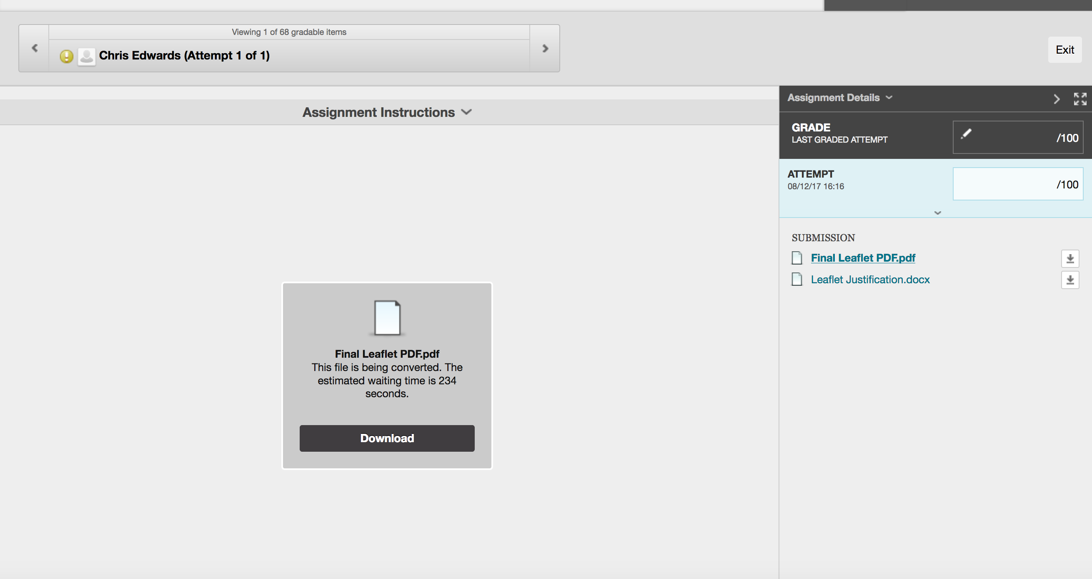
Click this arrow to enter feedback
If you see this instead of the students work, click refresh (or press Ctrl + R on your keyboard). If this doesn’t work, you’ll need to download the file.
Clicking these links allow you to move between the different files submitted. There should be no need to download them, but if you wish to you can

Slide 2
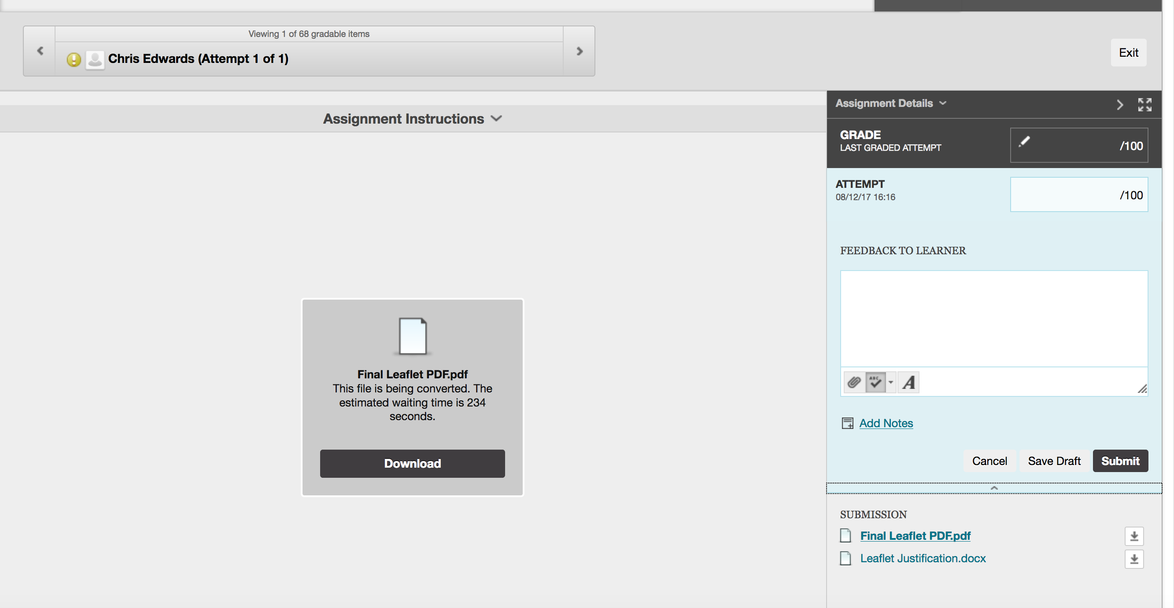
Enter feedback, can attach files if needed

Slide 3
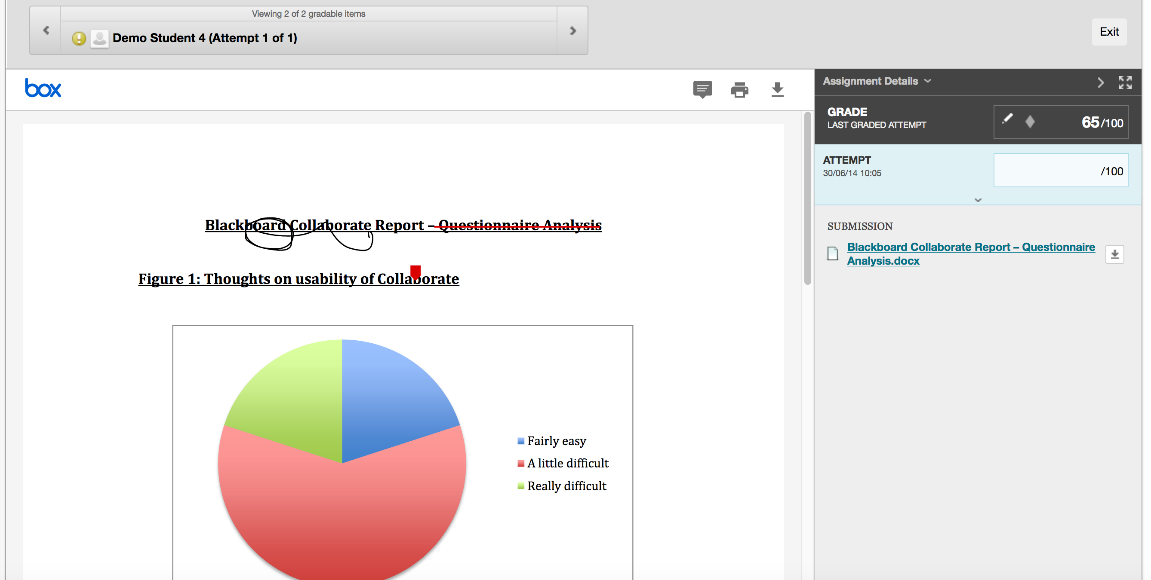
If you can see the assignment, click the comment box to insert a comment. You can also highlight text on the essay and add a comment

